Slide 1
CEN 3078 Computer Security
Final Review

Slide 2
Security architectures
Moving target defense, Defense by pretense
Anomaly detection
Threat intelligence collection
Penetration testing
Risk assessment and management
Module-3: Discussion Topics

Slide 3
Security architectures
Moving target defense, Defense by pretense
Anomaly detection
Threat intelligence collection
Penetration testing
Risk assessment and management
Module-3: Discussion Topics

Slide 4
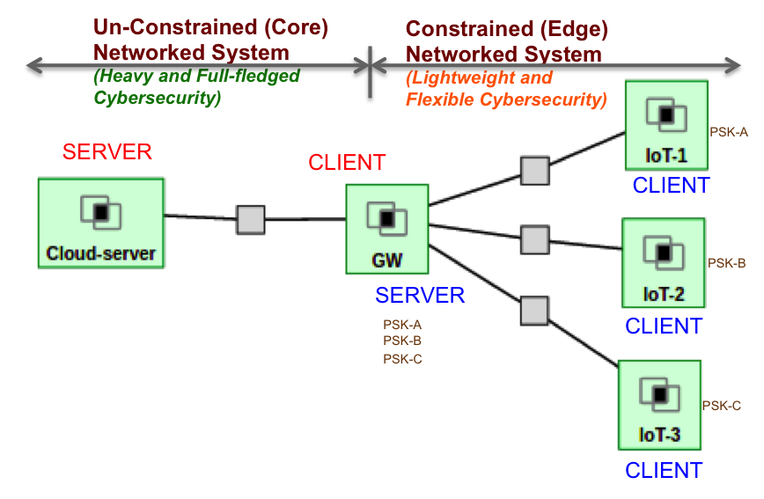
Lightweight and Flexible Security for IoT-based Public Safety Applications
IoT Gateway Middleware that uses machine learning to decide on tradeoffs in energy, latency and security in deciding computing policies at core or edge
Details in Module 4…
4

Slide 5
Manufacturing Application Security & Privacy
“Agile manufacturing” builds on the benefits of cloud computing (e.g., businesses
Don’t need to invest and manage expensive computing resources or computational solver licenses)
Need to bridge the collaboration gap between Manufacturing App Developer and a Cloud Engineer in “Manufacturing App Marketplaces”
Or AWS, GCP, …
5

Slide 6
Manufacturing App Marketplace Security Architecture
How to secure on-going efforts to scale-up the App Marketplace with user opt-in via a new web-access layer features?
(a) an integrated single sign-on authentication
(b) on-demand/secure access to run virtual desktops, and virtual machines for web servers to host the various Apps
(c) secure storage of results after the computation stages to protect intellectual property of the manufacturers’ App designs and data sets
(d) Defense against LoC using HoneyFiles (Defense by Pretense)
6

Slide 7
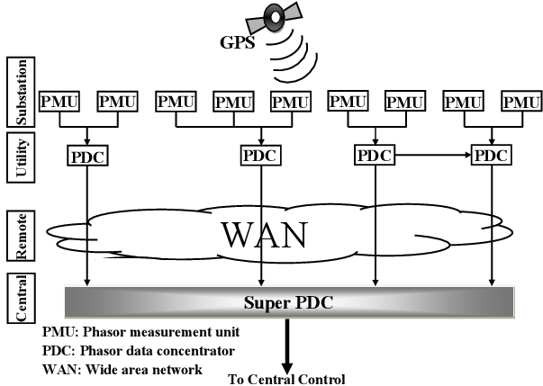
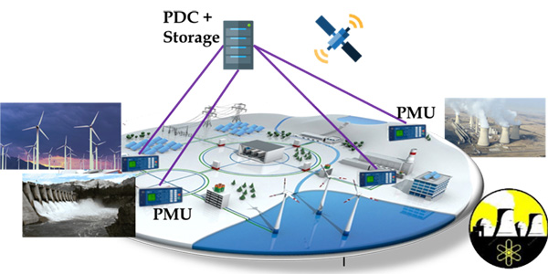
SmartGrid Application
Wide-area measurement and control systems (WAMCS) technology using Phasor Measurement Units (PMUs) is important
Helps guarantee resilience, stability, reliability, state estimation, control, and protection of next-generation power systems
However, there is an exponentially increasing number of PMUs and PDCs being deployed in the North American grid
Result is an explosion in data volume, which needs an efficient wide-area communication and computing infrastructure
7

Slide 8
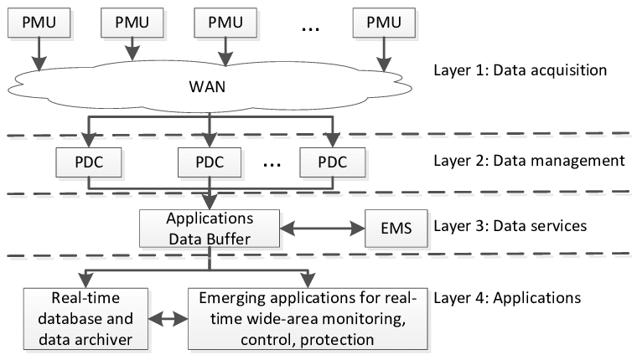
SmartGrid Application
As an example for power grids, according to UCAlug Open Smart Grid, every PMU (from a utility company) requires 600 to 1500 Kbps bandwidth, 20 ms to 200 ms latency, almost 100% reliability, and a 24-hour backup
WAMCS will require cloud computing resources (e.g., storage) and Gigabit per second bandwidth for satisfactory performance and resilience
Challenges are even more aggravated by the gradual transition from centralized to distributed systems for increased speed of data processing
With SDN
Privacy and Non-disclosure issues
8

Slide 9
SmartGrid Security Architecture
How to secure on-going efforts to store and process PMU data with utility companies opt-in via a new web-access layer and software-defined network features?
(a) an integrated single sign-on authentication
(b) on-demand/secure access to computation in the cloud to calculate e.g., secure state estimates in the power grids
(c) secure storage of results after the computation stages to protect intellectual property of the utility company’s data sets
(d) Defense against LoC attacks using Role-based Access Control
9

Slide 10
Security architectures
Moving target defense, Defense by pretense
Anomaly detection
Threat intelligence collection
Penetration testing
Risk assessment and management
Module-3: Discussion Topics

Slide 11
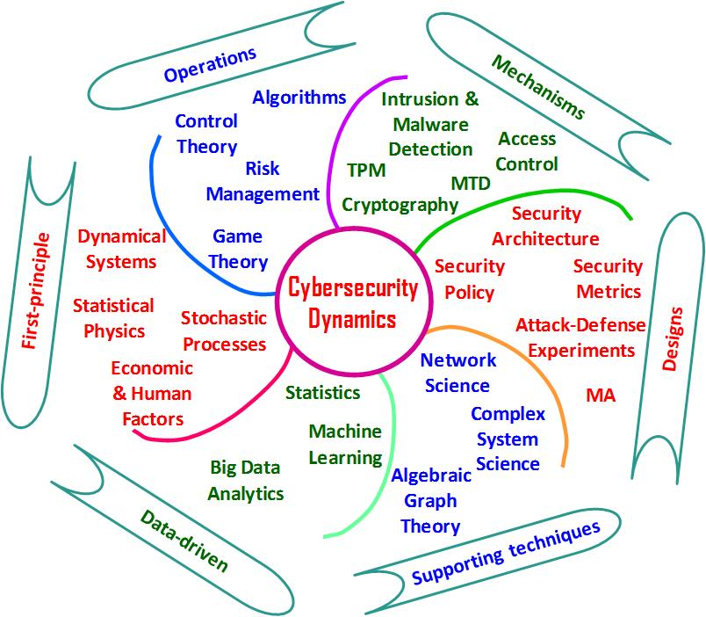
Data Science/ML and Cybersecurity
Data science/machine learning is critical to reveal “evidence” in cyber attack incidents
Without (good) data, there is no knowledge
Time-series data can be valuable for descriptive and predictive analytics of anomaly events
Useful for malware research, penetration testing, etc.
Threat intelligence collection supported by data is critical for decision making in real-life cyber operations/risk management
Helps cybersecurity engineers prioritize and focus on critical events than working by instinct
Many large organizations are hiring data scientists to help with cybersecurity analytics
11

Slide 12
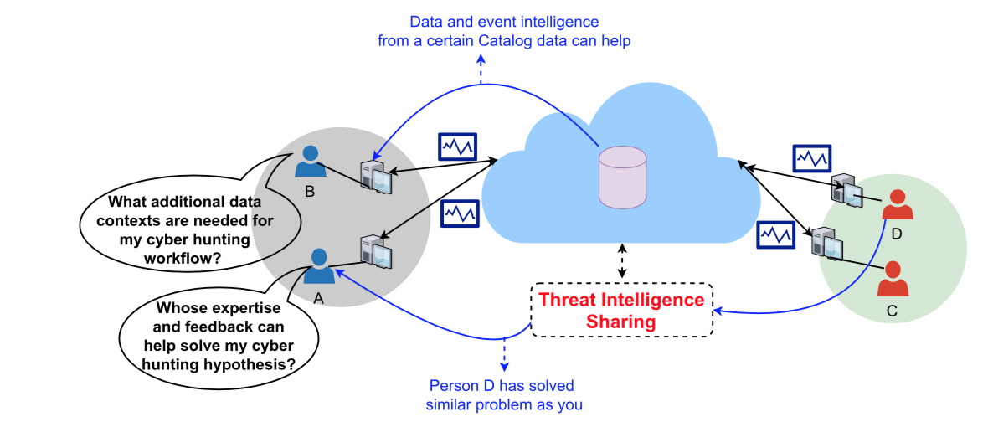
Data-driven Cyber Intelligence Collection
Threat intelligence sharing helps a cyber analyst’s monitoring objectives for ‘soft critical events’ and ‘silent critical events’ relating to either performance bottlenecks that may relate to security incidents…
12

Slide 13
Data-driven Cyber Intelligence Collection
Need to use statistical data planning policies in systems by considering variations of data structures of the many data silos involved
Active measurements (ping, traceroute, Iperf or other such one-end or double-end measurement probing)
Passive measurements (Netflow records, DNS, pcap, host logs, crash dumps, process logs, memory logs)
Monitoring objectives drive network and host device data collection, storage and analysis/visualization in cyber threat hunting
”Data farming” needs to be synergistic to “Data mining”
Monitoring strategies for expected performance/safety assurances violations due to ‘soft failures’ or ‘silent failures’
Versus ‘hard failures’ or ‘failure alarms’ where faults are more apparent to operations personnel using traditional monitoring systems or intrusion detection systems
13

Slide 14
Emerging AI Technologies for Cyber Hunting
AutoML - capability of automating the process of building, deploying, and managing machine learning models
Amazon SageMaker, Big Squid (self-service ML workbench), RapidMiner (visual ML workflow designer)
Augmented Intelligence - human-centered partnership model of people and AI working together
Enhance cognitive performance, including learning, decision making, and new experiences
Explainable AI - an ensemble of methods that make black-box AI algorithms’ outputs sufficiently understandable
Edge AI - use of AI techniques embedded in IoT endpoints, gateways, and edge devices to act on sensor data
Applications in streaming analytics for “right data at right time”
https://cra.org/ccc/wp-content/uploads/sites/2/2019/08/Community-Roadmap-for-AI-Research.pdf

Slide 15
Amazon SageMaker
Amazon SageMaker - fully managed service to label, build, train, and deploy ML models quickly
Amazon SageMaker Notebooks, Active learning for ground truth

Slide 16
Explainable AI (XAI)
ML models in new age of applications are opaque, non-intuitive
XAI improves understanding, trust for people

Slide 17
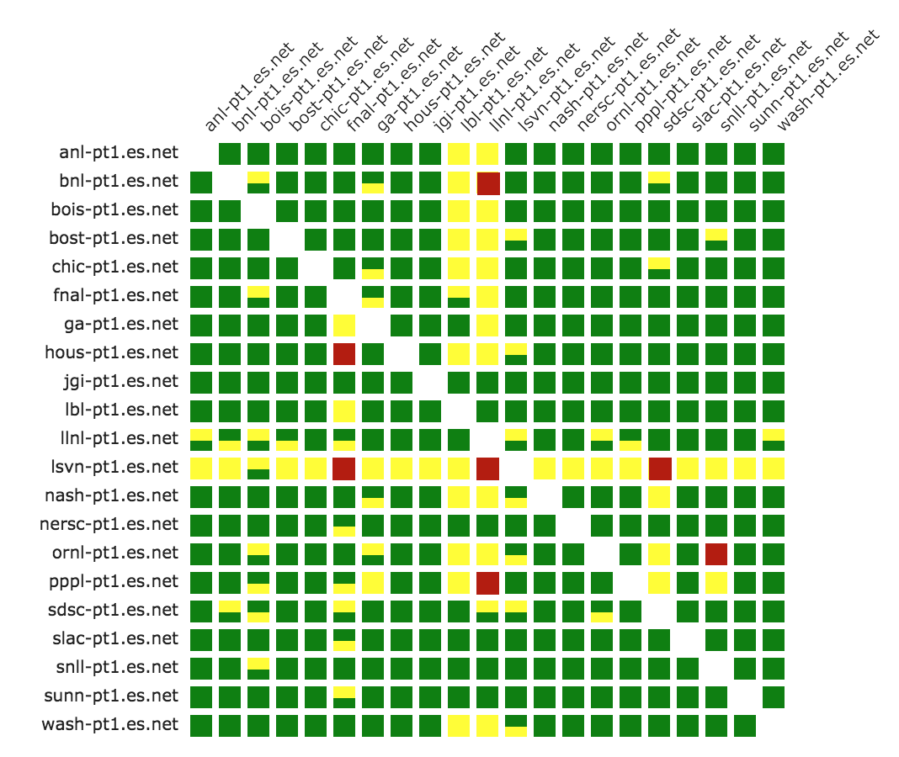
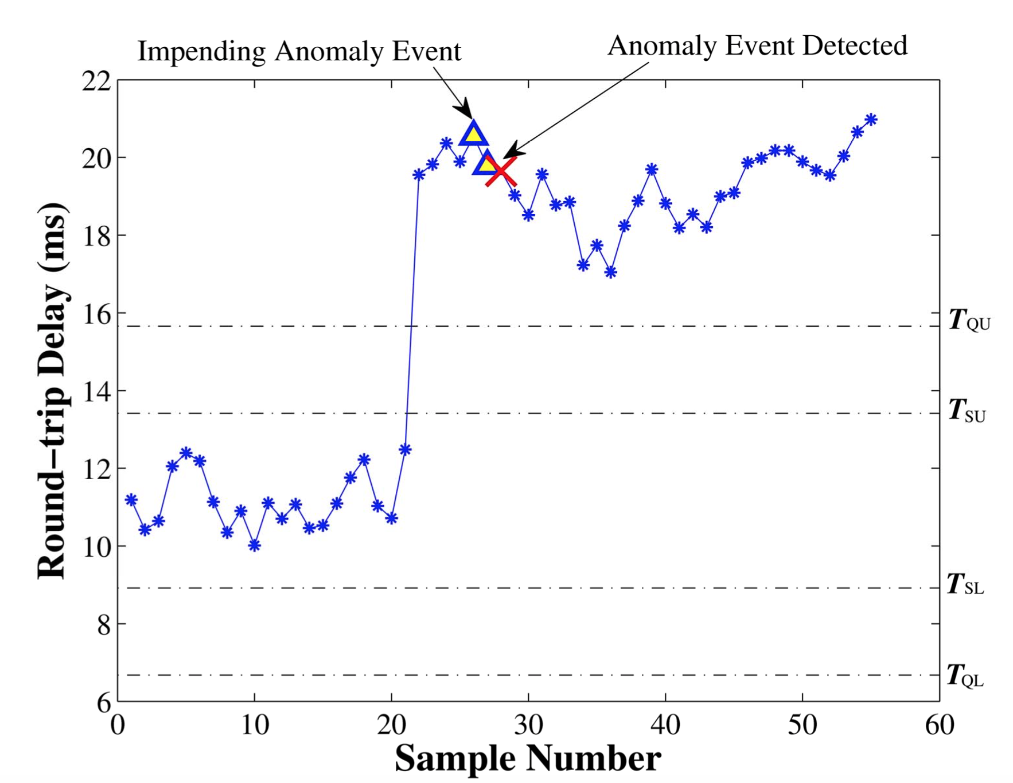
Explainable AI (XAI) Case Study
Anomaly detection → network-wide bottleneck event diagnosis or cyber attack detection/mitigation
→

Slide 18
Common Anomaly Detection Analysis Schemes
Statistical Techniques
Identify anomalies without assuming a stochastic model in the measurements
Classification Techniques
Identify the root-cause of anomalies through behavior observation (uses offline training/labeling; online testing on unlabeled measurements for category assignment)
Clustering Techniques
Category is not known apriori but placing data points that are similar close to each other – create category based on some distance function
Expert System Techniques
Root-cause analysis by imitiating knowledge of human expert; rule-based or model-based
Graph-theoretic Techniques
Causality (cause-effect) or dependency graph representations; algorithms help test various hypotheses or data perspectives

Slide 19
AI System: “Smart” Workflow to Knowledge-driven Decision Making
Sensing (Assess/Data)
Recognize important patterns/events in space and time
Filter out the noise
Trust in the data
Reasoning (Infer/Learn)
Turning patterns/events and their relationship into knowledge
Logic-based inference / evidence-based inference
Local/global situation assessment / similarity checking
Building/using knowledge base/catalog with successful example cases
Acting (Predict/Fix)
Establish communication goal and generate dialog for a specific crisis
Planning / Problem Solving using model predictions
Robotic Control using software-defined technologies

Slide 20
Security architectures
Moving target defense, Defense by pretense
Anomaly detection
Threat intelligence collection
Penetration testing
Risk assessment and management
Module-3: Discussion Topics

Slide 21
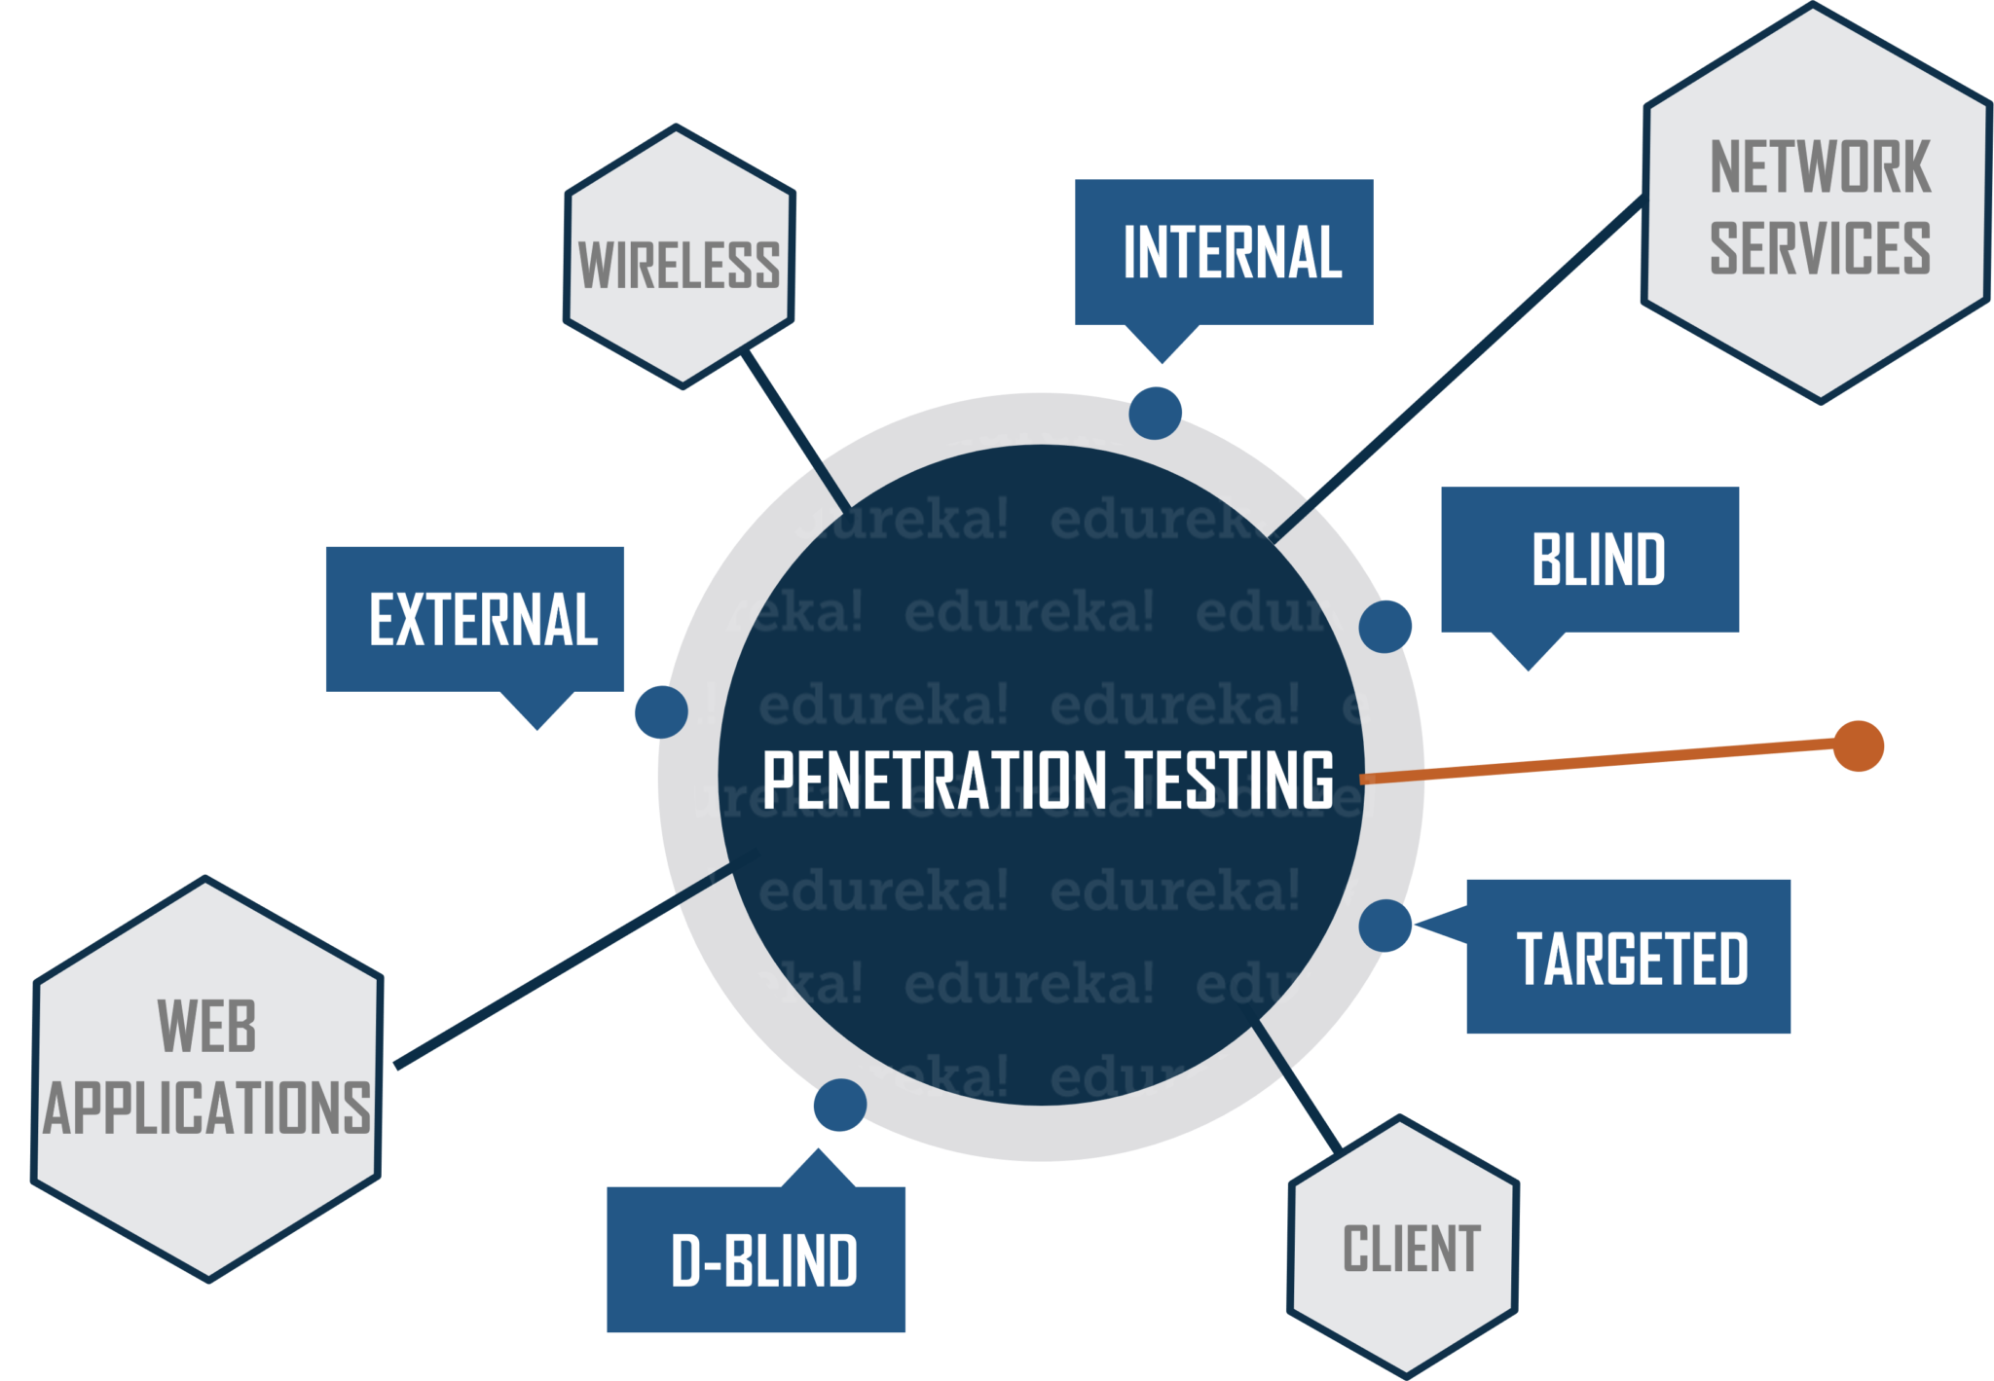

Penetration Testing / Pen Testing
Evaluate security of an IT infrastructure by safely trying (i.e., ethical hacking) to exploit vulnerabilities with written permission
Performed at different levels e.g., OS level, web apps level, wired/wireless network services level, end-user level, …
Assessment to help identify misconfigurations, risky user behavior and validate the efficacy of defense mechanisms
Goal is to find vulnerabilities before any attacker
Two types of Pen Testing
Black box: testing external components targeted with public or zero-day exploits (Black Hat)
White box: testing internal components (White Hat)
Could combine for Grey box testing
Minimum human supervision

Slide 22
Penetration Testing / Pen Testing
Manual or automated approaches are used
Pen tester goal is to exploit a particular vulnerability and use compromised hosts to launch new exploits at other internal resources
Document the combination of vulnerabilities exploited in a particular sequence
Testing ends if highest level of privilege escalation or highest levels of security clearance is attained
A report is produced for decision makers with:
Exposed vulnerabilities in terms of attack surfaces
Strategic conclusions on impact on business and operations
Priorities for remediation against threats and attack vectors
Approvals needed for fixes
Notifications are sent to relevant stakeholders e.g., senior management, vendors of hardware/software
Pen Tester must close out work (e.g., backdoors to maintain access, etc.) to avoid someone else from exploiting the vulnerabilities later
Minimum human supervision

Slide 23
Penetration Testing Steps
Information Intelligence
Using tools such as nmap, nslookup, people finders/Google search
Performing people profiling to target (e.g., via email or phone) as part of social engineering
Scanning and Enumerating
TCP and UDP port scanning to learn about target environment and find exposed vulnerabilities
Using tools such as metasploit, nc, nessus for high-speed discovery, configuration auditing, asset profiling, sensitive data discovery
Advanced Fingerprinting
Advanced fingerprinting of web applications, DNS, load balancers, etc. using scanning methods
Vulnerability Assessment
Overlaps with Pen Testing but largely non-intrusive to identify vulnerabilities in systems/networks and analyze security posture
Minimum human supervision

Slide 24
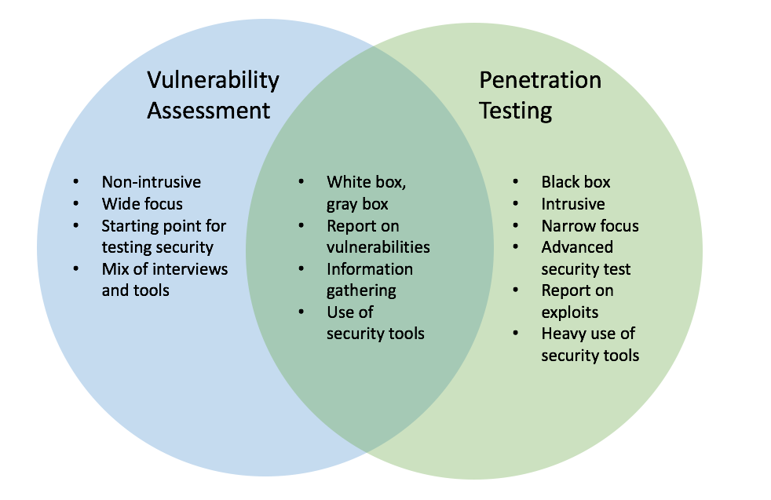
Vulnerability Assessment and Penetration Testing (VAPT)
Which one to choose and when, VA or PT? How do they differ from a security audit to check compliance with standard security policies and procedures?
Minimum human supervision
Automated/cheaper, minutes, scheduled, passive, “breadth over depth”
Popular Tools: Nessus, OpenVAS, Nikto, SAINT
Often manual/expensive, days, opportunistic/intuitive, aggressive, “depth over breadth”
Popular Tools: Metasploit, Kali Linux, NetSparker, Core Impact, Aircrack-ng, John Ripper, backtrack, wireshark
Notes:
Example:
We shall get into a real-life example to understand the difference between the two.
Let’s take Mr. X for an example. Mr. X is a heist specialist. We shall observe his plan for his next heist. He is planning to rob a Bank present in the middle of the city.
The Bank building is surrounded by a Police station, a Fire station, a Public Park [which stays closed at night] and a Pond. The bank building is a 20 floored building with a helipad on the top of it. Before he actually robs the bank, he needs to find the possible entry points into the Bank building.
The sides of the building that has a Police station and Fire station are impossible to breach. They operate 24X7 and who would dare to rob a bank using Cop’s den as the entry point! That leaves Mr. X with 3 other options. Yes, you got it right. He is also having the Roof as an Entry point [Remember Heath Ledger from the Batman Trilogy?].
The Rooftop seems to be an odd choice here as the building is only 20 floored and the chances of getting caught from people around you is very high. And, the Bank is the only single high rise building standing in the area. So, that makes the Roof entry a big NO! With the two leftover options, Mr. X starts analyzing the Lake as an entry point.
Lake can be a good mode of entry but, the visibility would be a concern. How would someone react if they see someone swimming at the midnight, that too towards the Bank building? The last option is the Public Park.
Let’s analyze the park in detail. It is closed to the public after six in the evening. Park has a lot of trees which gives the necessary shadow and supports for stealth mode. The park has a boundary wall which is shared with the Bank premises.
Now, all the analysis above can be said as Vulnerability scan. A scanner does all these things. To find out a vulnerable position to get in.
Going back to our story, let’s assume that Mr. X becomes successful in entering the bank through the Public park entry point. What does he do next? Whether he breaks into the Vault to get the cash or the deposit lockers to get the valuables.
This part is the Penetration testing. You get the access and try to exploit the system. You get to know the depth that you can go with this attack.

Slide 25
Vulnerability Assessment – dealing with Myths
“I have a firewall or use anti-virus to fend off attacks”
+) Firewalls can be effective to mitigate threats and isolate/protect
-) Hackers understand firewall strategies; can take down or by-pass a firewall through exploiting software bugs or admin oversight
-) End-to-end session hijacking not detectable by firewalls
“Web security is handled by using HTTPS”
+) Encryption of communication from source to destination is secure
-) Not effective against DDoS, brute force attacks, SQL injection
-) Organizations can be compromised by fake SSL certificates
“Our systems and data are not worthwhile targets”
+) Small business enterprises may not be attractive targets
-) More easy to attack since they may not take security seriously
-) Ransomeware attacks are frequent and impact small businesses
Minimum human supervision
Many other vulnerabilities: weak passwords, OS command injection, buffer overflow, privilege over-provisioning, unrestricted uploads of dangerous file types, outdated software, …

Slide 26
Security architectures
Moving target defense, Defense by pretense
Anomaly detection
Threat intelligence collection
Penetration testing
Risk assessment and management
Module-3: Discussion Topics

Slide 27
IT Security Management
What assets need to be protected
How are those assets threatened
What can be done to counter those threats
Helps in determining a clear view of an organization’s IT security objectives, security/privacy policies and general risk profile
Formal (iterative) process of answering questions such as:
Ensures that critical assets are sufficiently protected in a cost-effective manner
Security risk assessment is needed for each asset in the organization that requires protection
Provides the information necessary to decide what management, operational, and technical controls are needed to reduce the risks identified
Notes:
IT security management is the formal process of answering these questions, ensuring
that critical assets are sufficiently protected in a cost-effective manner. More specifically,
IT security management consists of first determining a clear view of an organization’s IT
security objectives and general risk profile. Next, an IT security risk assessment is needed
for each asset in the organization that requires protection; this assessment must answer
the three key questions listed above. It provides the information necessary to decide
what management, operational, and technical controls are needed to either reduce
the risks identified to an acceptable level or otherwise accept the resultant risk. This
chapter will consider each of these items. The process continues by selecting suitable
controls and then writing plans and procedures to ensure these necessary controls
are implemented effectively. That implementation must be monitored to determine if
the security objectives are met. The whole process must be iterated, and the plans and
procedures kept up-to-date, because of the rapid rate of change in both the technology
and the risk environment. We discuss the latter part of this process in Chapter 15. The
following chapters, then, address specific control areas relating to physical security in
Chapter 16, human factors in Chapter 17, and auditing in Chapter 18.

Slide 28
IT Security Management [ISO13335]
Helps to achieve and maintain appropriate levels of confidentiality, integrity, availability, accountability, authenticity, and reliability and involves functions such as:
Determining organizational IT security objectives, strategies, and policies
Determining organizational IT security requirements
Identifying and analyzing security threats to IT assets within the organization
Identifying and analyzing risks
Specifying appropriate safeguards
Monitoring the implementation and operation of safeguards that are necessary in order to cost effectively protect the information and services within the organization
Developing and implementing a security awareness program
Detecting and reacting to incidents
Notes:
[ISO13335] provides a conceptual framework for managing security. It defines
IT security management as follows:
IT SECURITY MANAGEMENT: A process used to achieve and maintain appropriate
levels of confidentiality, integrity, availability, accountability, authenticity, and reliability.
IT security management functions include:
• determining organizational IT security objectives, strategies, and policies
• determining organizational IT security requirements
• identifying and analyzing security threats to IT assets within the organization
• identifying and analyzing risks
• specifying appropriate safeguards
• monitoring the implementation and operation of safeguards that are necessary in
order to cost effectively protect the information and services within the organization
• developing and implementing a security awareness program
• detecting and reacting to incidents

Slide 29
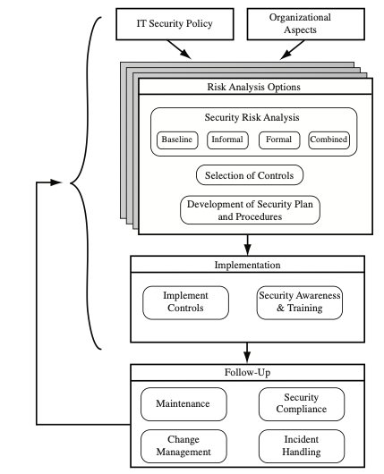
IT Security Management is a Cyclic Process
Cyclic process of must be repeated constantly in order to keep pace with the rapid changes in both IT technology and the risk environment
Notes:
This process is illustrated in Figure 14.1 (adapted from figure 1 in ISO27005 (Information security risk management, 2005) and
figure 1 in ISO13335, part 3]), with a particular
focus on the internal details relating to the risk assessment process. IT security management
needs to be a key part of an organization’s overall management plan. Similarly,
the IT security risk assessment process should be incorporated into the wider risk
assessment of all the organization’s assets and business processes. Hence, unless senior
management in an organization are aware of, and support, this process, it is unlikely
that the desired security objectives will be met and contribute appropriately to the
organization’s business outcomes. Note that IT management is not something undertaken
just once. Rather it is a cyclic process that must be repeated constantly in order
to keep pace with the rapid changes in both IT technology and the risk environment.

Slide 30
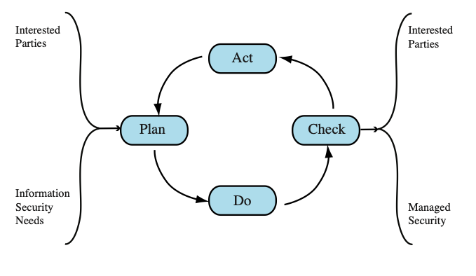
Plan – Do – Check - Act Process Model
Plan: Establish security policy, objectives, processes and procedures; perform risk assessment; develop risk treatment plan with appropriate selection of controls or acceptance of risk
Do: Implement the risk treatment plan
Check: Monitor and maintain the risk treatment plan
Act: Maintain and improve the information security risk management
process in response to incidents, review, or identified changes
Notes:
This process is illustrated in Figure 14.1 (adapted from figure 1 in ISO27005 (Information security risk management, 2005) and
figure 1 in ISO13335, part 3]), with a particular
focus on the internal details relating to the risk assessment process. IT security management
needs to be a key part of an organization’s overall management plan. Similarly,
the IT security risk assessment process should be incorporated into the wider risk
assessment of all the organization’s assets and business processes. Hence, unless senior
management in an organization are aware of, and support, this process, it is unlikely
that the desired security objectives will be met and contribute appropriately to the
organization’s business outcomes. Note that IT management is not something undertaken
just once. Rather it is a cyclic process that must be repeated constantly in order
to keep pace with the rapid changes in both IT technology and the risk environment.

Slide 31
Organizational Context and Security Policy
Maintained and updated regularly
Using periodic security reviews
Reflect changing technical/risk environments
Examine role and importance of IT systems in organization
Which essential decisions depend on the accuracy, currency, integrity, or availability of data managed by the IT systems?
What data created, managed, processed, and stored by the IT systems need protection?
What are the consequences to the organization of a security failure in their IT systems?
First examine organization’s IT security:
Objectives - wanted IT security outcomes
Strategies - how to meet objectives
Policies - identify what needs to be done
Notes:
The initial step in the IT security management process comprises an examination of
the organization’s IT security objectives, strategies, and policies in the context of the
organization’s general risk profile. This can only occur in the context of the wider
organizational objectives and policies, as part of the management of the organization.
Organizational security objectives identify what IT security outcomes should be
achieved. They need to address individual rights, legal requirements, and standards
imposed on the organization, in support of the overall organizational objectives.
Organizational security strategies identify how these objectives can be met. Organizational
security policies identify what needs to be done. These objectives, strategies, and
policies need to be maintained and regularly updated based on the results of periodic
security reviews to reflect the constantly changing technological and risk environments.
To help identify these organizational security objectives, the role and importance
of the IT systems in the organization is examined. The value of these systems
in assisting the organization achieve its goals is reviewed, not just the direct costs of
these systems. Questions that help clarify these issues include the following:
• What key aspects of the organization require IT support in order to function
efficiently?
• What tasks can only be performed with IT support?
• Which essential decisions depend on the accuracy, currency, integrity, or
availability of data managed by the IT systems?
• What data created, managed, processed, and stored by the IT systems need
protection?
• What are the consequences to the organization of a security failure in their IT
systems?
If the answers to some of the above questions show that IT systems are important
to the organization in achieving its goals, then clearly the risks to them should be
assessed and appropriate action taken to address any deficiencies identified. A list
of key organization security objectives should result from this examination.
Once the objectives are listed, some broad strategy statements can be developed.
These outline in general terms how the identified objectives will be met in a consistent
manner across the organization. The topics and details in the strategy statements
depend on the identified objectives, the size of the organization, and the importance
of the IT systems to the organization. The strategy statements should address the
approaches the organization will use to manage the security of its IT systems.

Slide 32
Organizational Security Policy
Needs to be addressed:
Scope and purpose including relation of objectives to business, legal, regulatory requirements
IT security requirements of assets (in terms of CIA triad)
Assignment of responsibilities across the organizational structure
Risk management approach
Security awareness and training
Integration of security into systems development
Information classification scheme
Contingency and business continuity planning
Incident detection and handling processes
How and when policy reviewed, and change control to it
Notes:
Given the organizational security objectives and strategies, an organizational
security policy is developed that describes what the objectives and strategies are and
the process used to achieve them. The organizational or corporate security policy
may be either a single large document or, more commonly, a set of related documents.
This policy typically needs to address at least the following topics:
• The scope and purpose of the policy
• The relationship of the security objectives to the organization’s legal and
regulatory obligations, and its business objectives
• IT security requirements in terms of confidentiality, integrity, availability,
accountability, authenticity, and reliability, particularly with regard to the
views of the asset owners
• The assignment of responsibilities relating to the management of IT security
and the organizational infrastructure
• The risk management approach adopted by the organization
• How security awareness and training is to be handled
• General personnel issues, especially for those in positions of trust
• Any legal sanctions that may be imposed on staff, and the conditions under
which such penalties apply
• Integration of security into systems development and procurement
• Definition of the information classification scheme used across the organization
• Contingency and business continuity planning
• Incident detection and handling processes
• How and when this policy should be reviewed
• The method for controlling changes to this policy
The intent of the policy is to provide a clear overview of how an organization’s IT
infrastructure supports its overall business objectives in general, and more specifically
what security requirements must be provided in order to do this most
effectively.

Slide 33
Security Risk Assessment
Critical component of process in IT security management
Ideally examine every organizational asset
Not feasible in practice
The time and effort required, even for large, well-resourced organizations, is clearly neither achievable nor cost effective
Approaches to identifying and mitigating risks to an organization’s IT infrastructure:
Baseline approach
Informal approach
Detailed risk analysis
Combined approach
Notes:
We now turn to the key risk management component of the IT security process.
This stage is critical, because without it there is a significant chance that resources
will not be deployed where most effective. The result will be that some risks are
not addressed, leaving the organization vulnerable, while other safeguards may be
deployed without sufficient justification, wasting time and money. Ideally every
single organizational asset is examined, and every conceivable risk to it is evaluated.
If a risk is judged to be too great, then appropriate remedial controls are deployed to
reduce the risk to an acceptable level. In practice this is clearly impossible. The time
and effort required, even for large, well-resourced organizations, is clearly neither
achievable nor cost effective. Even if possible, the rapid rate of change in both IT
technologies and the wider threat environment means that any such assessment
would be obsolete as soon as it is completed, if not earlier! Clearly some form of
compromise evaluation is needed.
Another issue is the decision as to what constitutes an appropriate level of
risk to accept. In an ideal world the goal would be to eliminate all risks completely.
Again, this is simply not possible. A more realistic alternative is to expend an amount
of resources in reducing risks proportional to the potential costs to the organization
should that risk occur. This process also must take into consideration the likelihood
of the risk’s occurrence. Specifying the acceptable level of risk is simply prudent
management and means that resources expended are reasonable in the context of
the organization’s available budget, time, and personnel resources. The aim of the
risk assessment process is to provide management with the information necessary for
them to make reasonable decisions on where available resources will be deployed.
Given the wide range of organizations, from very small businesses to global
multinationals and national governments, there clearly needs to be a range of alternatives
available in performing this process. There are a range of formal standards that
detail suitable IT security risk assessment processes, including ISO 13335, ISO 27005,
ISO 31000, and NIST SP 800-30. In particular, ISO 13335 recognizes four approaches
to identifying and mitigating risks to an organization’s IT infrastructure:
• Baseline approach
• Informal approach
• Detailed risk analysis
• Combined approach
The choice among these will be determined by the resources available to the organization
and from an initial high-level risk analysis that considers how valuable the IT systems
are and how critical to the organization’s business objectives. Legal and regulatory
constraints may also require specific approaches. This information should be determined
when developing the organization’s IT security objectives, strategies, and policies.

Slide 34
Baseline Approach
Goal is to implement agreed controls to provide protection against the most common threats
Forms a good base for further security measures
Use “industry best practice”
Easy, cheap, can be replicated
Gives no special consideration to variations in risk exposure
May give too much or too little security due to rough baseline
Generally recommended only for small organizations without the resources to implement more structured approaches
Notes:
The baseline approach to risk assessment aims to implement a basic general level
of security controls on systems using baseline documents, codes of practice, and
industry best practice . The advantages of this approach are that it doesn’t require
the expenditure of additional resources in conducting a more formal risk assessment
and that the same measures can be replicated over a range of systems. The
major disadvantage is that no special consideration is given to variations in the organization’s
risk exposure based on who they are and how their systems are used.
Also, there is a chance that the baseline level may be set either too high, leading to
expensive or restrictive security measures that may not be warranted, or set too low,
resulting in insufficient security and leaving the organization vulnerable.

Slide 35
Informal Approach
Involves conducting an informal, pragmatic risk analysis on organization’s IT systems
Exploits knowledge and expertise of analyst
Fairly quick and cheap
Judgments can be made about vulnerabilities and risks that baseline approach would not address
Some risks may be incorrectly assessed
Skewed by analyst’s views, varies over time
Suitable for small to medium sized organizations where IT systems are not necessarily essential
Notes:
The informal approach involves conducting some form of informal, pragmatic risk
analysis for the organization’s IT systems. This analysis does not involve the use of
a formal, structured process, but rather exploits the knowledge and expertise of the
individuals performing this analysis. These may either be internal experts, if available,
or, alternatively, external consultants. A major advantage of this approach is
that the individuals performing the analysis require no additional skills. Hence, an
informal risk assessment can be performed relatively quickly and cheaply. In addition,
because the organization’s systems are being examined, judgments can be
made about specific vulnerabilities and risks to systems for the organization that
the baseline approach would not address. Thus more accurate and targeted controls
may be used than would be the case with the baseline approach. There are a number
of disadvantages. Because a formal process is not used, there is a chance that some
risks may not be considered appropriately, potentially leaving the organization vulnerable.
Besides, because the approach is informal, the results may be skewed by the
views and prejudices of the individuals performing the analysis. It may also result in
insufficient justification for suggested controls, leading to questions over whether
the proposed expenditure is really justified. Lastly, there may be inconsistent results
over time as a result of differing expertise in those conducting the analysis.
The use of the informal approach would generally be recommended for small
to medium-sized organizations where the IT systems are not necessarily essential to
meeting the organization’s business objectives and where additional expenditure on
risk analysis cannot be justified.

Slide 36
Detailed Risk Analysis (Formal Process)
Most comprehensive approach
Assess using formal structured process
Number of stages
Identify threats and vulnerabilities to assets
Identify likelihood of risk occurring and consequences
Significant cost in time, resources, expertise
May be a legal requirement to use
Suitable for large organizations with IT systems critical to their business objectives
Notes:
The third and most comprehensive approach is to conduct a detailed risk assessment
of the organization’s IT systems, using a formal structured process. This provides
the greatest degree of assurance that all significant risks are identified and their
implications considered. This process involves a number of stages, including
identification of assets, identification of threats and vulnerabilities to those assets,
determination of the likelihood of the risk occurring and the consequences to the
organization should that occur, and hence the risk the organization is exposed to. With
that information, appropriate controls can be chosen and implemented to address
the risks identified. The advantages of this approach are that it provides the most
detailed examination of the security risks of an organization’s IT system, and produces
strong justification for expenditure on the controls proposed. It also provides
the best information for continuing to manage the security of these systems as they
evolve and change. The major disadvantage is the significant cost in time, resources,
and expertise needed to perform such an analysis. The time taken to perform this
analysis may also result in delays in providing suitable levels of protection for some
systems. The details of this approach are discussed in the next section.
The use of a formal, detailed risk analysis is often a legal requirement for
some government organizations and businesses providing key services to them. This
may also be the case for organizations providing key national infrastructure. For
such organizations, there is no choice but to use this approach. It may also be the
approach of choice for large organizations with IT systems critical to their business
objectives and with the resources available to perform this type of analysis.

Slide 37
Combined Approach
Combines elements of the baseline, informal, and detailed risk analysis approaches
Aim is to provide reasonable levels of protection as quickly as possible and adjust the protection controls deployed on key systems over time
Approach starts with the implementation of suitable baseline security recommendations on all systems
Next, systems either exposed to high risk levels or critical to the organization's business objectives are identified in the high-level risk assessment
A decision can then be made to possibly conduct an immediate informal risk assessment on key systems, with the aim of relatively quickly tailoring controls to more accurately reflect their requirements
Lastly, an ordered process of performing detailed risk analyses of these systems can be instituted
Over time, this can result in the most appropriate and cost-effective security controls being selected and implemented on these systems
Notes:
The last approach combines elements of the baseline, informal, and detailed risk
analysis approaches. The aim is to provide reasonable levels of protection as quickly
as possible, and then to examine and adjust the protection controls deployed on key
systems over time. The approach starts with the implementation of suitable baseline
security recommendations on all systems. Next, systems either exposed to high risk
levels or critical to the organization’s business objectives are identified in the high-level
risk assessment. A decision can then be made to possibly conduct an immediate
informal risk assessment on key systems, with the aim of relatively quickly
tailoring controls to more accurately reflect their requirements. Lastly, an ordered
process of performing detailed risk analyses of these systems can be instituted. Over
time this can result in the most appropriate and cost-effective security controls being
selected and implemented on these systems. This approach has a significant number
of advantages. The use of the initial high-level analysis to determine where further
resources need to be expended, rather than facing a full detailed risk analysis of
all systems, may well be easier to sell to management. It also results in the development
of a strategic picture of the IT resources and where major risks are likely
to occur. This provides a key planning aid in the subsequent management of the
organization’s security. The use of the baseline and informal analyses ensures that a
basic level of security protection is implemented early. And it means that resources
are likely to be applied where most needed and that systems most at risk are likely
to be examined further reasonably early in the process. However, there are some
disadvantages. If the initial high-level analysis is inaccurate, then some systems for
which a detailed risk analysis should be performed may remain vulnerable for some
time. Nonetheless, the use of the baseline approach should ensure a basic minimum
security level on such systems. Further, if the results of the high-level analysis are
reviewed appropriately, the chance of lingering vulnerability is minimized.
ISO13335 considers that for most organizations, in most circumstances, this
approach is the most cost effective. Consequently its use is highly recommended.

Slide 38
Detailed Risk Analysis
Provides the most accurate evaluation of an organization's IT system’s security risks
Highest cost
Initially focused on addressing defense security concerns
Often mandated by government organizations and associated businesses
Notes:
The formal, detailed security risk analysis approach provides the most accurate
evaluation of an organization’s IT system’s security risks, but at the highest cost.
This approach has evolved with the development of trusted computer systems,
initially focused on addressing defense security concerns, as we discuss in Chapter 13 .
The original security risk assessment methodology was given in the Yellow Book
standard (CSC-STD-004-85 June 1985), one of the original U.S. TCSEC rainbow
book series of standards. Its focus was entirely on protecting the confidentiality of
information, reflecting the military concern with information classification. The
recommended rating it gave for a trusted computer system depended on difference
between the minimum user clearance and the maximum information classification.
Specifically it defined a risk index as
Risk Index = Max Info Sensitivity - Min User Clearance
A table in this standard, listing suitable categories of systems for each risk level,
was used to select the system type. Clearly this limited approach neither adequately
reflects the range of security services required nor the wide range of possible threats.
Over the years since, the process of conducting a security risk assessment that does
consider these issues has evolved.

Slide 39
Threat Identification
Availability
Authenticity
Reliability
Accountability
Integrity
Threat is Anything that might hinder or prevent an asset from providing appropriate levels of the key security services
Confidentiality
Notes:
Answering the first of these questions involves
identifying potential threats to assets. In the broadest sense, a threat is anything
that might hinder or prevent an asset from providing appropriate levels of the key
security services: confidentiality, integrity, availability, accountability, authenticity,
and reliability. Note that one asset may have multiple threats, and a single threat
may target multiple assets.

Slide 40
Risk Treatment Alternatives
Risk acceptance
Choosing to accept a risk level greater than normal for business reasons
Risk avoidance
Not proceeding with the activity or system that creates this risk
Risk transfer
Sharing responsibility for the risk with a third party
Reduce consequence
Modifying the structure or use of the assets at risk to reduce the impact on the organization should the risk occur
Reduce likelihood
Implement suitable controls to lower the chance of the vulnerability being exploited
The loss of this capability is traded off against the reduced risk profile
E.g., taking out insurance against the risk occurring, by entering into a contract with another organization
E.g., implementing an off-site backup process, developing a disaster recovery plan, or arranging for data and processing to be replicated over multiple sites
E.g., include technical or administrative controls such as deploying firewalls and access tokens, or change policies
Notes:
There are five broad alternatives
available to management for treating identified risks:
Risk acceptance: Choosing to accept a risk level greater than normal for business
reasons. This is typically due to excessive cost or time needed to treat the
risk. Management must then accept responsibility for the consequences to the
organization should the risk eventuate.
• Risk avoidance: Not proceeding with the activity or system that creates this
risk. This usually results in loss of convenience or ability to perform some
function that is useful to the organization. The loss of this capability is traded
off against the reduced risk profile.
• Risk transfer: Sharing responsibility for the risk with a third party. This is
typically achieved by taking out insurance against the risk occurring, by entering
into a contract with another organization, or by using partnership or joint
venture structures to share the risks and costs should the threat eventuate.
• Reduce consequence: By modifying the structure or use of the assets at risk
to reduce the impact on the organization should the risk occur. This could
be achieved by implementing controls to enable the organization to quickly
recover should the risk occur. Examples include implementing an off-site
backup process, developing a disaster recovery plan, or arranging for data and
processing to be replicated over multiple sites.
• Reduce likelihood: By implementing suitable controls to lower the chance of
the vulnerability being exploited. These could include technical or administrative
controls such as deploying firewalls and access tokens, or procedures such
as password complexity and change policies. Such controls aim to improve the
security of the asset, making it more difficult for an attack to succeed by reducing the
vulnerability of the asset.
If either of the last two options is chosen, then possible treatment controls
need to be selected and their cost effectiveness evaluated. There is a wide range
of available management, operational, and technical controls that may be used.
These would be surveyed to select those that might address the identified threat
most effectively and to evaluate the cost to implement against the benefit gained.
Management would then choose among the options as to which should be adopted
and plan for their implementation. We introduce the range of controls often used
and the use of security plans and policies in Chapter 15 and provide further details
of some specific control areas in Chapters 16 – 18 .

Slide 41
Analyze Risks
Specify likelihood of occurrence of each identified threat to asset given existing controls
Specify consequence should threat occur
Derive overall risk rating for each threat
Risk = probability threat occurs x cost to organization
Hard to determine accurate probabilities and realistic cost consequences
Use qualitative and quantitative ratings, heat maps
Notes:
Having identified key assets and the likely threats and vulnerabilities they are
exposed to, the next step is to determine the level of risk each of these poses to the
organization. The aim is to identify and categorize the risks to assets that threaten
the regular operations of the organization. Risk analysis also provides information
to management to help managers evaluate these risks and determine how best to
treat them. Risk analysis involves first specifying the likelihood of occurrence of
each identified threat to an asset, in the context of any existing controls. Next, the
consequence to the organization is determined, should that threat eventuate. Lastly,
this information is combined to derive an overall risk rating for each threat. The
ideal would be to specify the likelihood as a probability value and the consequence
as a monetary cost to the organization should it occur. The resulting risk is then
simply given as
Risk = (Probability that threat occurs) x (Cost to organization)
This can be directly equated to the value the threatened asset has for the organization,
and hence specify what level of expenditure is reasonable to reduce the
probability of its occurrence to an acceptable level. Unfortunately, it is often
extremely hard to determine accurate probabilities, realistic cost consequences,
or both. This is particularly true of intangible assets, such as the loss of confidentiality
of a trade secret. Hence, most risk analyses use qualitative, rather than
quantitative, ratings for both these items. The goal is then to order the resulting
risks to help determine which need to be most urgently treated, rather than to
give them an absolute value.

Slide 42
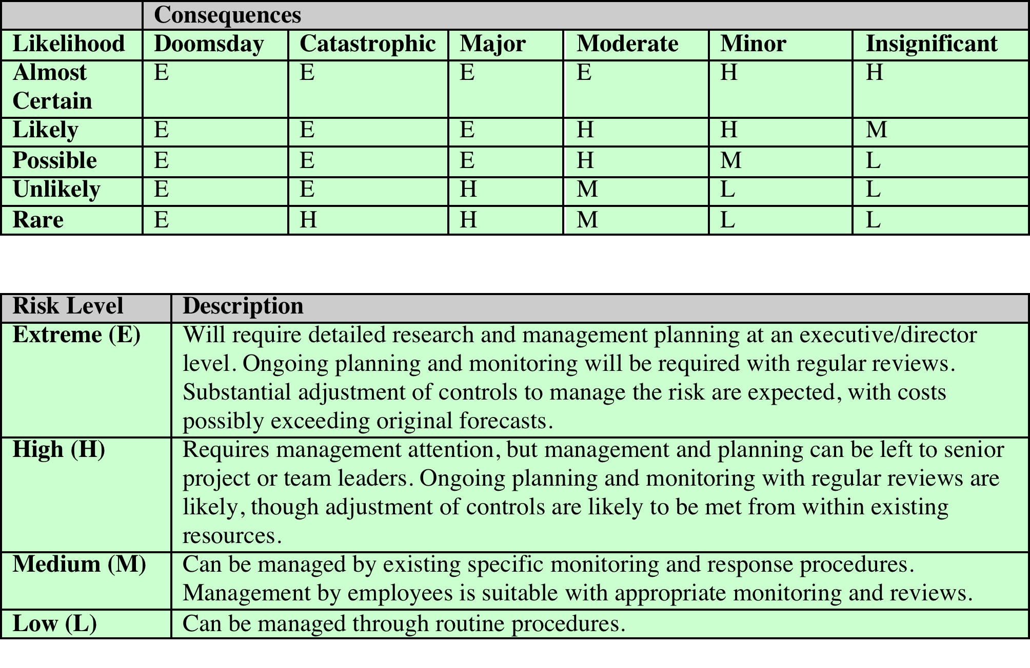
Risk Level Determination
***https://www.ready.gov/business/planning/risk-assessment
Notes:
Once the likelihood and consequence
of each specific threat have been identified, a final level of risk can be assigned.
This is typically determined using a table that maps these values to a risk level,
such as those shown in Table 14.4. This table details the risk level assigned to each
combination. Such a table provides the qualitative equivalent of performing the
ideal risk calculation using quantitative values. It also indicates the interpretation
of these assigned levels.

Slide 43
Network Scanning and Vulnerability Scanning
Digital Forensics
Cybersecurity Engineering
Security policies
Firewalls
Authentication, Access controls
Federated trust
IoT/Cloud middleware
Module 4 – Defense Architectures and Design

Slide 44
Network Scanning and Vulnerability Scanning
Digital Forensics
Cybersecurity Engineering
Security policies
Firewalls
Authentication, Access controls
Federated trust
IoT/Cloud middleware
Module 4 – Defense Architectures and Design

Slide 45
Introduction
Any system should be periodically assessed for vulnerabilities
Methods for assessment include:
Vulnerability scanning
Penetration testing
Auditing
Tools are available to scan networks for vulnerabilities
Security procedures can provide a network environment with more secure computing

Slide 46
Basics of Assessing a System
Knowing how to begin securing a system can be daunting
The stages of assessing a system’s security can be categorized into the six Ps:
Patch – check and keep system patches up to date
Ports – shut down any unneeded ports
Protect – implement a firewall and IDS
Policies – enforce written policies on computer security
Probe – regularly probe network for security flaws
Physical – use policies for securing server rooms, individual workstations, and other physical equipment

Slide 47
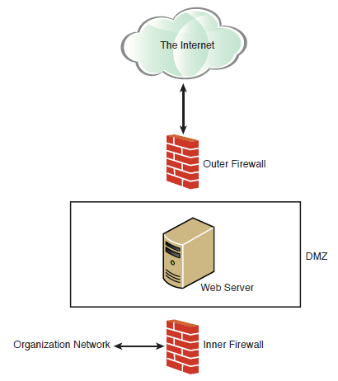
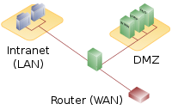
DMZ (Demilitarized Zone)

Slide 48
Scanning Your Network
To keep a network secure, routinely check the network for vulnerabilities and flaws
Common vulnerability scanners include:
NESSUS – the premiere network vulnerability scanner
OWASP Zap – the standard for web application vulnerability
Shodan – used by black hat hackers and security professionals
Kali Linux – Linux distribution with open-source tools for cybersecurity, digital forensics, and penetration testing
Vega – free, open-source scanner for web applications
OpenVAS – open-source vulnerability scanner that includes several services and tools

Slide 49
Testing and Scanning Standards
There are specific standards that relate to vulnerability scans and penetration tests
Common testing and scanning standards include:
NIST 800-115 – general guide for testing and assessment
NSA-IAM – excellent guide for penetration tests
PCI DSS – standard used by major credit card companies
National Vulnerability Database
U.S. government repository of vulnerability data
Uses the Security Content Automation Protocol (SCAP)

Slide 50
Summary
Periodically assess a network or system for security vulnerabilities
Weekly for high-security sites
Quarterly for noncritical or low-security sites
Safe computing involves securing all computers, networks, and servers, and using common sense on the Web
Apply security practices and standards to all aspects of network systems

Slide 51
Network Scanning and Vulnerability Scanning
Digital Forensics
Cybersecurity Engineering
Security policies
Firewalls
Authentication, Access controls
Federated trust
IoT/Cloud middleware
Module 4 – Defense Architectures and Design

Slide 52
Objectives
Understand basic systems engineering concepts
Understand how to integrate systems engineering into cybersecurity
Utilize engineering tools in cybersecurity
Explain the use of standards in cybersecurity engineering

Slide 53
Introduction
The field of cybersecurity is growing rapidly
Presents challenges for defining the profession
Many different approaches are used in cybersecurity and cybersecurity education
Practiced as a business management discipline
Approached as a computer science sub-discipline
Wide range of technical backgrounds and skill sets for practitioners
Cybersecurity can be viewed as an engineering discipline—a sub-discipline of systems engineering

Slide 54
Defining Cybersecurity Engineering
Cybersecurity and Systems Engineering
Cybersecurity involves diverse computer systems, human processes, operating systems, and more
Cybersecurity could be considered a sub-discipline of systems engineering
Systems engineering is concerned with a given system, or system of systems, throughout the system life cycle
Begins with the concept phase and continues through system disposal
This is an appropriate approach for cybersecurity engineering

Slide 55
Defining Cybersecurity Engineering
Applying Engineering to Cybersecurity
A cybersecurity project should begin by defining the requirements
Use the SMART acronym for effective requirements:
Specific
Measurable
Achievable
Realistic
Timely
A tool to aid in planning is the Work Breakdown Structure (WBS), which breaks a project into smaller tasks; see the next slide for an example

Slide 56
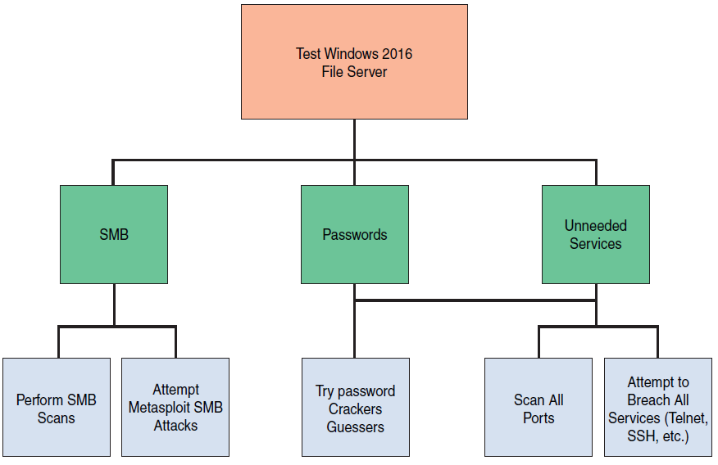
Work Breakdown Structure
Notes:
SMB – Server Message block

Slide 57
Standards
Every engineering discipline has specific standards
Standards in the cybersecurity industry include:
RMF: Guide for Applying the Risk Management Framework
ISO 27001: Standard for Information Security Management System (ISMS)
ISO 27004: How to Measure Information Security
NIST SP 800-63B: Digital Identity Guidelines

Slide 58
Modeling
Cybersecurity engineering is directed toward some threat
Modeling ensures you are building your security to counter the threats specific to your systems
Different modeling concepts include:
STRIDE: Identifies threats in six categories
PASTA: Risk-centric seven-step methodology
DREAD: Mnemonic for risk rating using five categories

Slide 59
Summary
There are various applications of systems engineering to cybersecurity
The goal is to apply a methodical, systematic approach to cybersecurity
Penetration testing should be a carefully engineered process mapped to specific testing requirements
It is beneficial to model cybersecurity scenarios to better understand system security requirements

Slide 60
Network Scanning and Vulnerability Scanning
Digital Forensics
Cybersecurity Engineering
Security policies
Firewalls
Authentication, Access controls
Federated trust
IoT/Cloud middleware
Module 4 – Defense Architectures and Design

Slide 61
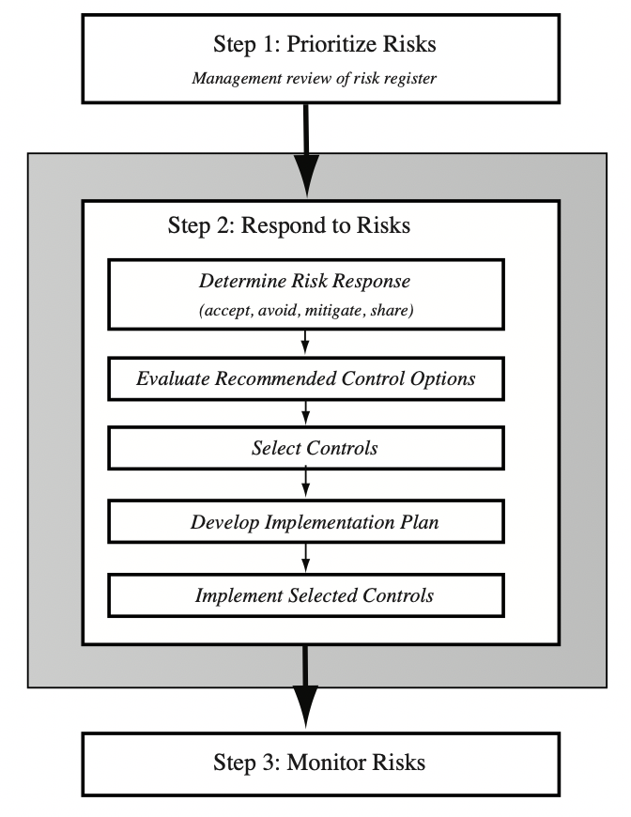
IT Security Management Controls

Slide 62
Security Control
Control is defined as:
“An action, device, procedure, or other measure that reduces risk by eliminating or preventing a security violation, by minimizing the harm it can cause, or by discovering and reporting it to enable corrective action.”
Notes:
A risk assessment on an organization’s IT systems identifies areas needing treatment.
The next step, as shown in Figure 14.1 on risk analysis options, is to select suitable
controls to use in this treatment. An IT security control, safeguard, or countermeasure
(the terms are used interchangeably) helps to reduce risks. We use the following
definition:
“ An action, device, procedure, or other measure that reduces risk by eliminating or preventing a
security violation, by minimizing the harm it can cause, or by discovering and reporting it to enable corrective action.”

Slide 63
Control Classifications
Management controls
Focus on security policies, planning, guidelines, and standards that influence the selection of operational and technical controls to reduce the risk of loss and to protect the organization’s mission
These controls refer to issues that management needs to address
Operational controls
Address the correct implementation and use of security policies and standards, ensuring consistency in security operations and correcting identified operational deficiencies
These controls relate to mechanisms and procedures that are primarily implemented by people rather than systems
They are used to improve the security of a system or group of systems
Technical controls
Involve the security policies on correct use of hardware and software security capabilities in systems
These range from simple to complex measures that work together to secure critical and sensitive data, information, and IT systems functions
Notes:
Some controls address multiple risks at the same time, and selecting such controls can
be very cost effective. Controls can be classified as belonging to one of the following
classes (although some controls include features from several of these):
• Management controls: Focus on security policies, planning, guidelines, and
standards that influence the selection of operational and technical controls to
reduce the risk of loss and to protect the organization’s mission. These controls
refer to issues that management needs to address. We discuss a number of these
in Chapters 14 and 15.
• Operational controls: Address the correct implementation and use of security
policies and standards, ensuring consistency in security operations and correcting
identified operational deficiencies. These controls relate to mechanisms
and procedures that are primarily implemented by people rather than systems.
They are used to improve the security of a system or group of systems. We will
discuss some of these in Chapters 16 and 17.
• Technical controls: Involve the correct use of hardware and software security
capabilities in systems. These range from simple to complex measures that work
together to secure critical and sensitive data, information, and IT systems functions.

Slide 64
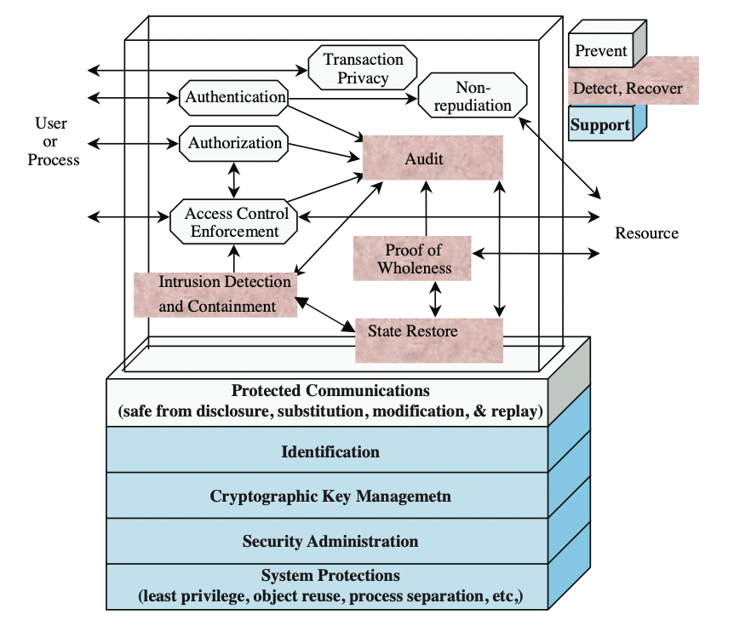
Technical Security Controls
Notes:
Some controls address multiple risks at the same time, and selecting such controls can
be very cost effective. Controls can be classified as belonging to one of the following
classes (although some controls include features from several of these):
• Management controls: Focus on security policies, planning, guidelines, and
standards that influence the selection of operational and technical controls to
reduce the risk of loss and to protect the organization’s mission. These controls
refer to issues that management needs to address. We discuss a number of these
in Chapters 14 and 15.
• Operational controls: Address the correct implementation and use of security
policies and standards, ensuring consistency in security operations and correcting
identified operational deficiencies. These controls relate to mechanisms
and procedures that are primarily implemented by people rather than systems.
They are used to improve the security of a system or group of systems. We will
discuss some of these in Chapters 16 and 17.
• Technical controls: Involve the correct use of hardware and software security
capabilities in systems. These range from simple to complex measures that work
together to secure critical and sensitive data, information, and IT systems functions.

Slide 65
IT Security Plan
Should include
Risks, recommended controls, action priority
Selected controls, resources needed
Responsible personnel, implementation dates
Maintenance requirements
Provides details of:
What will be done
What resources are needed
Who is responsible
Goal is to detail the actions needed to improve the identified deficiencies in the risk profile
Notes:
Having identified a range of possible controls from which management has selected
some to implement, an IT security plan should then be created, as indicated in
Figures 14.1 and 15.1 . This is a document that provides details as to what will be
done, what resources are needed, and who will be responsible. The goal is to detail
the actions needed to improve the identified deficiencies in the organization’s risk
profile in a timely manner. NIST SP 800-30 (Risk Management Guide for Information Technology
Systems, September 2012) suggests that this plan should include details of:
• Risks (asset/threat/vulnerability combinations)
• Recommended controls (from the risk assessment)
• Action priority for each risk
• Selected controls (on the basis of the cost-benefit analysis)
• Required resources for implementing the selected controls
• Responsible personnel
• Target start and end dates for implementation
• Maintenance requirements and other comments

Slide 66
Security Plan Implementation
Notes:
These details are summarized in an implementation plan table, such as
that shown in Table 15.4 . This illustrates an example implementation plan for
the example risk identified and shown in Table 14.5 . The suggested controls are
specific examples of remote access, auditable event, user identification, system
backup, and configuration change controls, applied to the identified threatened
asset. All of them are chosen, because they are neither costly nor difficult to
implement. They do require some changes to procedures. The relevant network
administration staff must be notified of these changes. Staff members may also
require training on the correct implementation of the new procedures and their
rights and responsibilities.

Slide 67
Security Plan Implementation (2)
IT security plan documents:
What needs to be done for each selected control
Personnel responsible
Resources and time frame
Identified personnel:
Implement new or enhanced controls
May need system configuration changes, upgrades or new system installation
May also involve development of new or extended procedures
Need to be encouraged and monitored by management
When implementation is completed management authorizes the system for operational use
Notes:
The next phase in the IT security management process, as indicated in Figure 14.1, is
to manage the implementation of the controls detailed in the IT security plan. This
comprises the do stage of the cyclic implementation model discussed in Chapter 14 .
The implementation phase comprises not only the direct implementation of the
controls as detailed in the security plan, but also the associated specific training and
general security awareness programs for the organization.
The IT security plan documents what needs to be done for each selected control,
along with the personnel responsible, and the resources and time frame to
be used. The identified personnel then undertake the tasks needed to implement
the new or enhanced controls, be they technical, managerial, or operational.
This may involve some combination of system configuration changes, upgrades,
or new system installation. It may also involve the development of new or
extended procedures to document practices needed to achieve the desired
security goals. Note that even technical controls typically require associated
operational procedures to ensure their correct use. The use of these procedures
needs to be encouraged and monitored by management.
The implementation process should be monitored to ensure its correctness.
This is typically performed by the organizational security officer, who checks that:
• The implementation costs and resources used stay within identified bounds.
• The controls are correctly implemented as specified in the plan, in order that
the identified reduction in risk level is achieved.
• The controls are operated and administered as needed.
When the implementation is successfully completed, management needs to
authorize the system for operational use. This may be a purely informal process
within the organization. Alternatively, especially in government organizations,
this may be part of a formal process resulting in accreditation of the system
as meeting required standards. This is usually associated with the installation,
certification, and use of trusted computing system, as we will discuss in Chapter 27 .
In these cases an external accrediting body will verify the documented evidence of
the correct design and implementation of the system.

Slide 68
Security Plan Implementation Follow-up
Security management is a cyclic process
Constantly repeated to respond to changes in the IT systems and the risk environment
Need to monitor implemented controls
Evaluate changes for security implications
Otherwise increase chance of security breach
Includes a number of aspects
Maintenance of security controls
Security compliance checking
Change and configuration management
Incident handling
Notes:
The IT security management process does not end with the implementation of
controls and the training of personnel. As we noted in Chapter 14, it is a cyclic
process, constantly repeated to respond to changes in the IT systems and the risk
environment. The various controls implemented should be monitored to ensure
their continued effectiveness. Any proposed changes to systems should be checked
for security implications and the risk profile of the affected system reviewed if
necessary. Unfortunately, this aspect of IT security management often receives
the least attention and in many cases is added as an afterthought, if at all. Failure
to do so can greatly increase the likelihood that a security failure will occur.
This follow-up stage of the management process includes a number of aspects:
• Maintenance of security controls
• Security compliance checking
• Change and configuration management
• Incident handling
Any of these aspects might indicate that changes are needed to the previous stages in
the IT security management process. An obvious example is that if a breach should
occur, such as a virus infection of desktop systems, then changes may be needed to
the risk assessment, to the controls chosen, or to the details of their implementation.
This can trigger a review of earlier stages in the process.

Slide 69
Security Plan Maintenance
Need continued maintenance and monitoring of implemented controls to ensure continued correct functioning and appropriateness
Goal is to ensure controls perform as intended
Periodic review of controls
Upgrade of controls to meet new requirements
System changes do not impact controls
Address new threats or vulnerabilities
Notes:
The first aspect concerns the continued maintenance and monitoring of the
implemented controls to ensure their continued correct functioning and
appropriateness. It is important that someone has responsibility for this maintenance
process, which is generally coordinated by the organization’s security officer.
The maintenance tasks include ensuring that:
• Controls are periodically reviewed to verify that they still function as intended.
• Controls are upgraded when new requirements are discovered.
• Changes to systems do not adversely affect the controls.
• New threats or vulnerabilities have not become known.
This review includes regular analysis of log files to ensure various system
components are functioning as expected, and to determine a baseline of activity
against which abnormal events can be compared when handling incidents.
We discuss security auditing further in Chapter 18 .
The goal of maintenance is to ensure that the controls continue to perform as
intended, and hence that the organization’s risk exposure remains as chosen. Failure
to maintain controls could lead to a security breach with a potentially significant
impact on the organization.

Slide 70
Network Scanning and Vulnerability Scanning
Digital Forensics
Cybersecurity Engineering
Security policies
Firewalls
Authentication, Access controls
Federated trust
IoT/Cloud middleware
Module 4 – Defense Architectures and Design

Slide 71
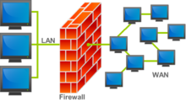
The Need For Firewalls
Internet connectivity is essential
However it creates a threat
Effective means of protecting LANs
Inserted between the premises network and the Internet to establish a controlled link
Can be a single computer system or a set of two or more systems working together
Used as a perimeter defense
Single choke point to impose security and auditing
Insulates the internal systems from external networks
Notes:
Internet connectivity is no longer optional for organizations. The information
and services available are essential to the organization. Moreover, individual users
within the organization want and need Internet access, and if this is not provided
via their LAN, they could use a wireless broadband capability from their PC to an
Internet service provider (ISP). However, while Internet access provides benefits to
the organization, it enables the outside world to reach and interact with local network
assets. This creates a threat to the organization. While it is possible to equip
each workstation and server on the premises network with strong security features,
such as intrusion protection, this may not be sufficient and in some cases is not cost effective.
Consider a network with hundreds or even thousands of systems, running
various operating systems, such as different versions of Windows, MacOS, and
Linux. When a security flaw is discovered, each potentially affected system must be
upgraded to fix that flaw. This requires scaleable configuration management and
aggressive patching to function effectively. While difficult, this is possible and is necessary
if only host-based security is used. A widely accepted alternative or at least
complement to host-based security services is the firewall. The firewall is inserted
between the premises network and the Internet to establish a controlled link and to
erect an outer security wall or perimeter. The aim of this perimeter is to protect the
premises network from Internet-based attacks and to provide a single choke point
where security and auditing can be imposed. The firewall may be a single computer
system or a set of two or more systems that cooperate to perform the firewall function.
The firewall, then, provides an additional layer of defense, insulating the internal
systems from external networks. This follows the classic military doctrine of
“defense in depth,” which is just as applicable to IT security.

Slide 72
Firewall Characteristics
Design Goals:
All traffic from inside to outside, and vice versa, must pass through the firewall
Only authorized traffic as defined by the local security policy will be allowed to pass
The firewall itself is immune to penetration
Not always true
The firewall of a large-sized enterprise network can typically have a ruleset or ACL (Access Control List) comprising 10K+ rules
Last-matching rules are located at the bottom of the ruleset and consume the most CPU processing power of firewalls
If these rules get discovered by an attacker, the attacker can effectively launch a low-rate DoS attack that can bring the firewall to its knees
Countermeasures: Random delay, periodic re-arranging of rules or caching
K. Salah, K. Sattar, A. Baig, M. Squalli, P. Calyam, “Resiliency of Popular Network Firewalls against Remote Discovery of Last-Matching Rules”, ACM Conference on Security of Information and Networks (SIN), 2009.
Notes:
[BELL94] lists the following design goals for a firewall:
1. All traffic from inside to outside, and vice versa, must pass through the firewall.
This is achieved by physically blocking all access to the local network except via
the firewall. Various configurations are possible, as explained later in this chapter.
2. Only authorized traffic, as defined by the local security policy, will be allowed
to pass. Various types of firewalls are used, which implement various types of
security policies, as explained later in this chapter.
3. The firewall itself is immune to penetration. This implies the use of a hardened
system with a secured operating system, as we will describe in Chapter 12.

Slide 73
Firewall Access Policy
A critical component in the planning and implementation of a firewall is specifying a suitable access policy
This lists the types of traffic authorized to pass through the firewall
Includes address ranges, protocols, applications and content types
This policy should be developed from the organization’s information security risk assessment and policy
Should be developed from a broad specification of which traffic types the organization needs to support
Then refined to detail the filter elements which can then be implemented within an appropriate firewall topology
Notes:
A critical component in the planning and implementation of a firewall is
specifying a suitable access policy. This lists the types of traffic authorized to pass
through the firewall, including address ranges, protocols, applications and content
types. This policy should be developed from the organization’s information security
risk assessment and policy, that we discuss in Chapters 14 and 15. This policy
should be developed from a broad specification of which traffic types the organization
needs to support. It is then refined to detail the filter elements we discuss next,
which can then be implemented within an appropriate firewall topology.

Slide 74
Firewall Filter Characteristics
Characteristics that a firewall access policy could use to filter traffic include (as per NIST SP 800-41):
IP address and protocol values
This type of filtering is used by packet filter and stateful inspection firewalls
Typically used to limit access to specific services
Application protocol
This type of filtering is used by an application-level gateway that relays and monitors the exchange of information for specific application protocols
User identity
Typically for inside users who identify themselves using some form of secure authentication technology
Network activity
Controls access based on considerations such as the time or request, rate of requests, or other activity patterns
Notes:
NIST SP 800-41 (Guidelines on Firewalls and Firewall Policy, September 2009)
lists a range of characteristics that a firewall access policy could use to filter traffic,
including:
• IP Address and Protocol Values: Controls access based on the source or
destination addresses and port numbers, direction of flow being inbound or
outbound, and other network and transport layer characteristics. This type of
filtering is used by packet filter and stateful inspection firewalls. It is typically
used to limit access to specific services.
• Application Protocol: Controls access on the basis of authorized application
protocol data. This type of filtering is used by an application-level gateway
that relays and monitors the exchange of information for specific application
protocols, for example, checking Simple Mail Transfer Protocol (SMTP) e-mail for spam, or HTPP Web requests to
authorized sites only.
• User Identity: Controls access based on the users identity, typically for inside
users who identify themselves using some form of secure authentication technology,
such as IPSec (Chapter 22).
• Network Activity: Controls access based on considerations such as the time or
request, for example, only in business hours; rate of requests, for example, to detect scanning
attempts; or other activity patterns.

Slide 75
Firewall Capabilities and Limits
Capabilities:
Defines a single choke point
Provides a location for monitoring security events
Convenient platform for several Internet functions that are not security related
Can serve as the platform for IPSec
IPSec is a standard suite of protocols between 2 communication points across the IP network that provide data authentication, integrity, and confidentiality; It also defines the encrypted, decrypted and authenticated packets
Limitations:
Cannot protect against attacks bypassing firewall
May not protect fully against internal threats
Improperly secured wireless LAN can be accessed from outside the organization
Laptop, or portable storage device may be infected outside the corporate network then used internally
Notes:
Before proceeding to the details of firewall types and configurations, it is best
to summarize what one can expect from a firewall. The following capabilities are
within the scope of a firewall:
1. A firewall defines a single choke point that attempts to keep unauthorized
users out of the protected network, prohibit potentially vulnerable services
from entering or leaving the network, and provide protection from various
kinds of IP spoofing and routing attacks. The use of a single choke point
simplifies security management because security capabilities are consolidated
on a single system or set of systems.
2. A firewall provides a location for monitoring security-related events. Audits
and alarms can be implemented on the firewall system.
3. A firewall is a convenient platform for several Internet functions that are not
security related. These include a network address translator, which maps local
addresses to Internet addresses, and a network management function that
audits or logs Internet usage.
4. A firewall can serve as the platform for IPSec. Using the tunnel mode capability
described in Chapter 22 , the firewall can be used to implement virtual
private networks.
Firewalls have their limitations, including the following:
1. The firewall cannot protect against attacks that bypass the firewall. Internal
systems may have dial-out or mobile broadband capability to connect to
an ISP. An internal LAN may support a modem pool that provides dial-in
capability for traveling employees and telecommuters.
2. The firewall may not protect fully against internal threats, such as a disgruntled
employee or an employee who unwittingly cooperates with an external
attacker.
3. An improperly secured wireless LAN may be accessed from outside the
organization. An internal firewall that separates portions of an enterprise
network cannot guard against wireless communications between local systems
on different sides of the internal firewall.
4. A laptop, PDA, or portable storage device may be used and infected outside
the corporate network and then attached and used internally.

Slide 76
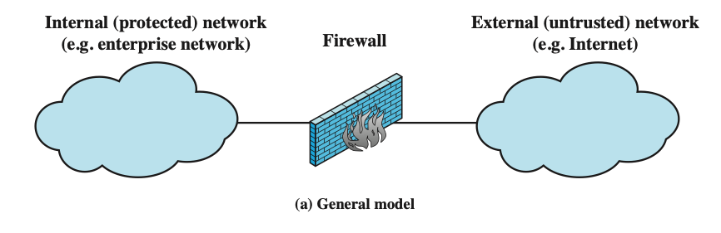
Types of Firewalls
Notes:
A firewall can monitor network traffic at a number of levels, from low-level network
packets, either individually or as part of a flow, to all traffic within a transport connection,
up to inspecting details of application protocols. The choice of which level
is appropriate is determined by the desired firewall access policy. It can operate as a
positive filter, allowing to pass only packets that meet specific criteria, or as a negative
filter, rejecting any packet that meets certain criteria. The criteria implement the
access policy for the firewall that we discussed in the previous section. Depending
on the type of firewall, it may examine one or more protocol headers in each packet,
the payload of each packet, or the pattern generated by a sequence of packets. In this
section, we look at the principal types of firewalls.

Slide 77
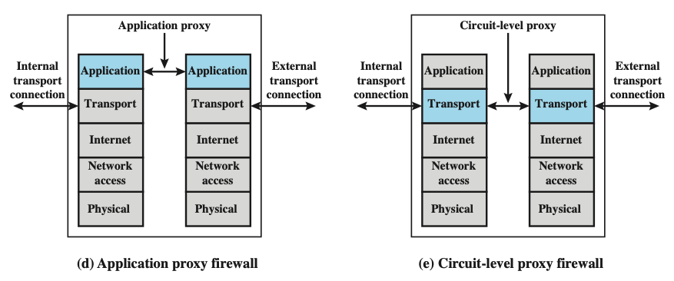
Types of Firewalls (2)
Notes:
A firewall can monitor network traffic at a number of levels, from low-level network
packets, either individually or as part of a flow, to all traffic within a transport connection,
up to inspecting details of application protocols. The choice of which level
is appropriate is determined by the desired firewall access policy. It can operate as a
positive filter, allowing to pass only packets that meet specific criteria, or as a negative
filter, rejecting any packet that meets certain criteria. The criteria implement the
access policy for the firewall that we discussed in the previous section. Depending
on the type of firewall, it may examine one or more protocol headers in each packet,
the payload of each packet, or the pattern generated by a sequence of packets. In this
section, we look at the principal types of firewalls.

Slide 78
Packet Filtering Firewall
Applies rules to each incoming and outgoing IP packet
Typically a list of rules based on matches in the IP or TCP header
Forwards or discards the packet based on rules match
Two default policies:
Discard - prohibit unless expressly permitted
More conservative, controlled, visible to users
Forward - permit unless expressly prohibited
Easier to manage and use but less secure
Filtering rules are based on information contained in a network packet
Source IP address
Destination IP address
Source and destination transport-level address
IP protocol field
Interface
Notes:
A packet filtering firewall applies a set of rules to each incoming and outgoing
IP packet and then forwards or discards the packet ( Figure 9.1b ). The firewall
is typically configured to filter packets going in both directions (from and to
the internal network). Filtering rules are based on information contained in a
network packet:
• Source IP address: The IP address of the system that originated the IP packet
(e.g., 192.178.1.1)
• Destination IP address: The IP address of the system the IP packet is trying to
reach (e.g., 192.168.1.2)
• Source and destination transport-level address: The transport-level (e.g., TCP
or UDP) port number, which defines applications such as SNMP or HTTP.
• IP protocol field: Defines the transport protocol
• Interface: For a firewall with three or more ports, which interface of the firewall
the packet came from or for which interface of the firewall the packet is destined.
The packet filter is typically set up as a list of rules based on matches to fields
in the IP or TCP header. If there is a match to one of the rules, that rule is invoked
to determine whether to forward or discard the packet. If there is no match to any
rule, then a default action is taken. Two default policies are possible:
• Default = discard: That which is not expressly permitted is prohibited.
• Default = forward: That which is not expressly prohibited is permitted.
The default discard policy is more conservative. Initially, everything is blocked,
and services must be added on a case-by-case basis. This policy is more visible to
users, who are more likely to see the firewall as a hindrance. However, this is the
policy likely to be preferred by businesses and government organizations. Further,
visibility to users diminishes as rules are created. The default forward policy increases
ease of use for end users but provides reduced security; the security administrator
must, in essence, react to each new security threat as it becomes known. This policy
may be used by generally more open organizations, such as universities.

Slide 79
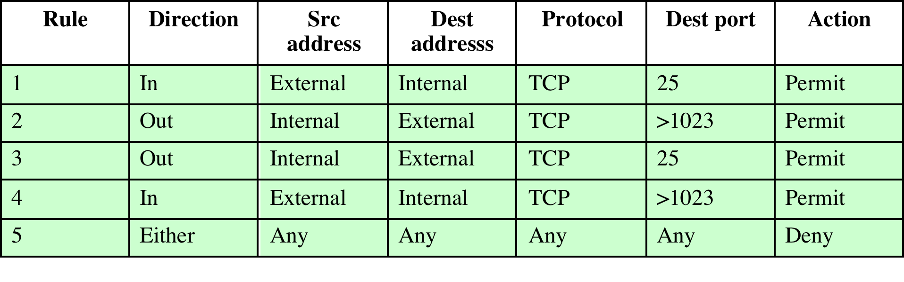
Packet Filtering Examples
Do you see problems with this rule set?
Rule 4 allows external traffic to any destination port above 1023. As an example of an exploit of this rule, an
external attacker can open a connection from the attacker’s port 5150 to an internal Web proxy server on port 8080. This is supposed to be forbidden and could allow an attack on the server.
To counter this attack, the firewall rule set can be configured with a source port field for each row. For rules 2 and 4, the source port is set to 25; for rules 1 and 3, the source port is set to >1023.
Notes:
Table 9.1 is a simplified example of a rule set for SMTP traffic. The goal is to
allow inbound and outbound email traffic but to block all other traffic. The rules are
applied top to bottom to each packet. The intent of each rule is:
1. Inbound mail from an external source is allowed (port 25 is for SMTP incoming).
2. This rule is intended to allow a response to an inbound SMTP connection.
3. Outbound mail to an external source is allowed.
4. This rule is intended to allow a response to an inbound SMTP connection.
5. This is an explicit statement of the default policy. All rule sets include this rule
implicitly as the last rule.
There are several problems with this rule set. Rule 4 allows external traffic
to any destination port above 1023. As an example of an exploit of this rule, an
external attacker can open a connection from the attacker’s port 5150 to an internal
Web proxy server on port 8080. This is supposed to be forbidden and could allow an
attack on the server. To counter this attack, the firewall rule set can be configured
with a source port field for each row. For rules 2 and 4, the source port is set to 25;
for rules 1 and 3, the source port is set to >1023.
But a vulnerability remains. Rules 3 and 4 are intended to specify that any
inside host can send mail to the outside. A TCP packet with a destination port of
25 is routed to the SMTP server on the destination machine. The problem with this
rule is that the use of port 25 for SMTP receipt is only a default; an outside machine
could be configured to have some other application linked to port 25. As the revised
rule 4 is written, an attacker could gain access to internal machines by sending packets
with a TCP source port number of 25. To counter this threat, we can add an
ACK flag field to each row. For rule 4, the field would indicate that the ACK flag
must be set on the incoming packet. Rule 4 would now look like this:
Rule 4
Direction In
Src address External
Src port 25
Dest address Internal
Protocol TCP
Dest port >1023
Flag ACK
Action. Permit
The rule takes advantage of a feature of TCP connections. Once a connection
is set up, the ACK flag of a TCP segment is set to acknowledge segments sent from
the other side. Thus, this rule allows incoming packets with a source port number of
25 that include the ACK flag in the TCP segment.

Slide 80
Packet Filtering Advantages and Weaknesses
Advantages:
Simplicity
Typically transparent to users and are very fast
Weaknesses:
Cannot prevent attacks that employ application specific vulnerabilities or functions
Limited logging functionality
Do not support advanced user authentication
Vulnerable to attacks on TCP/IP protocol bugs
Improper configuration can lead to breaches
Notes:
One advantage of a packet filtering firewall is its simplicity. Also, packet filters
typically are transparent to users and are very fast. NIST SP 800-41 lists the following
weaknesses of packet filter firewalls:
• Because packet filter firewalls do not examine upper-layer data, they cannot
prevent attacks that employ application-specific vulnerabilities or functions.
For example, a packet filter firewall cannot block specific application
commands; if a packet filter firewall allows a given application, all functions
available within that application will be permitted.
• Because of the limited information available to the firewall, the logging
functionality present in packet filter firewalls is limited. Packet filter logs
normally contain the same information used to make access control decisions
(source address, destination address, and traffic type).
• Most packet filter firewalls do not support advanced user authentication
schemes. Once again, this limitation is mostly due to the lack of upper-layer
functionality by the firewall.
• Packet filter firewalls are generally vulnerable to attacks and exploits that take
advantage of problems within the TCP/IP specification and protocol stack,
such as network layer address spoofing . Many packet filter firewalls cannot
detect a network packet in which the OSI Layer 3 addressing information has
been altered. Spoofing attacks are generally employed by intruders to bypass
the security controls implemented in a firewall platform.
• Finally, due to the small number of variables used in access control decisions,
packet filter firewalls are susceptible to security breaches caused by improper
configurations. In other words, it is easy to accidentally configure a packet
filter firewall to allow traffic types, sources, and destinations that should be
denied based on an organization’s information security policy.
Some of the attacks that can be made on packet filtering firewalls and the
appropriate countermeasures are the following:
• IP address spoofing : The intruder transmits packets from the outside with a
source IP address field containing an address of an internal host. The attacker
hopes that the use of a spoofed address will allow penetration of systems that
employ simple source address security, in which packets from specific trusted
internal hosts are accepted. The countermeasure is to discard packets with an
inside source address if the packet arrives on an external interface. In fact, this
countermeasure is often implemented at the router external to the firewall.
• Source routing attacks: The source station specifies the route that a packet
should take as it crosses the Internet, in the hopes that this will bypass security
measures that do not analyze the source routing information. A countermeasure
is to discard all packets that use this option.
• Tiny fragment attacks: The intruder uses the IP fragmentation option to create
extremely small fragments and force the TCP header information into
a separate packet fragment. This attack is designed to circumvent filtering
rules that depend on TCP header information. Typically, a packet filter
will make a filtering decision on the first fragment of a packet. All subsequent
fragments of that packet are filtered out solely on the basis that
they are part of the packet whose first fragment was rejected. The attacker
hopes that the filtering firewall examines only the first fragment and that
the remaining fragments are passed through. A tiny fragment attack can be
defeated by enforcing a rule that the first fragment of a packet must contain
a predefined minimum amount of the transport header. If the first fragment
is rejected, the filter can remember the packet and discard all subsequent
fragments.

Slide 81
Types of Firewalls
Notes:
A firewall can monitor network traffic at a number of levels, from low-level network
packets, either individually or as part of a flow, to all traffic within a transport connection,
up to inspecting details of application protocols. The choice of which level
is appropriate is determined by the desired firewall access policy. It can operate as a
positive filter, allowing to pass only packets that meet specific criteria, or as a negative
filter, rejecting any packet that meets certain criteria. The criteria implement the
access policy for the firewall that we discussed in the previous section. Depending
on the type of firewall, it may examine one or more protocol headers in each packet,
the payload of each packet, or the pattern generated by a sequence of packets. In this
section, we look at the principal types of firewalls.

Slide 82
Stateful Inspection Firewall
Tightens rules for TCP traffic by creating a directory of outbound TCP connections
There is an entry for each currently established connection
Packet filter allows incoming traffic to high numbered ports only for those packets that fit the profile of one of the entries in this directory
Reviews packet information but also records information about TCP connections
Keeps track of TCP sequence numbers to prevent attacks that depend on the sequence number
Inspects data for protocols, especially critical commands
Notes:
A traditional packet filter makes filtering decisions on an individual packet basis
and does not take into consideration any higher-layer context. To understand what
is meant by context and why a traditional packet filter is limited with regard to context,
a little background is needed. Most standardized applications that run on top
of TCP follow a client/server model. For example, for the Simple Mail Transfer
Protocol (SMTP), e-mail is transmitted from a client system to a server system.
The client system generates new e-mail messages, typically from user input. The
server system accepts incoming e-mail messages and places them in the appropriate
user mailboxes. SMTP operates by setting up a TCP connection between client
and server, in which the TCP server port number, which identifies the SMTP server
application, is 25. The TCP port number for the SMTP client is a number between
1024 and 65535 that is generated by the SMTP client.
In general, when an application that uses TCP creates a session with a remote
host, it creates a TCP connection in which the TCP port number for the remote
(server) application is a number less than 1024 and the TCP port number for the
local (client) application is a number between 1024 and 65535. The numbers less
than 1024 are the “well-known” port numbers and are assigned permanently to
particular applications (e.g., 25 for server SMTP). The numbers between 1024 and
65535 are generated dynamically and have temporary significance only for the
lifetime of a TCP connection.
A simple packet filtering firewall must permit inbound network traffic on all
these high-numbered ports for TCP-based traffic to occur. This creates a vulnerability
that can be exploited by unauthorized users.

Slide 83
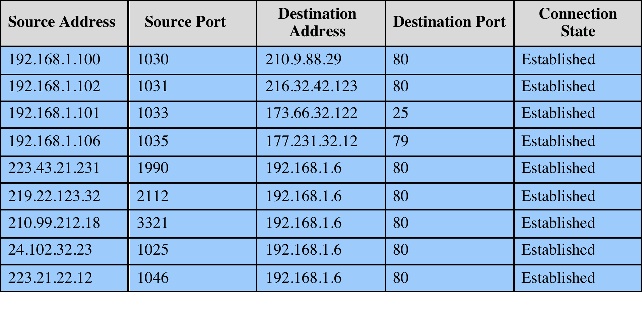
Example Stateful Firewall Connection State
Notes:
A stateful inspection packet firewall tightens up the rules for TCP traffic by
creating a directory of outbound TCP connections, as shown in Table 9.2 . There is
an entry for each currently established connection. The packet filter will now allow
incoming traffic to high-numbered ports only for those packets that fit the profile of
one of the entries in this directory.
A stateful packet inspection firewall reviews the same packet information
as a packet filtering firewall, but also records information about TCP connections
(Figure 9.1c). Some stateful firewalls also keep track of TCP sequence numbers
to prevent attacks that depend on the sequence number, such as session hijacking.
Some even inspect limited amounts of application data for some well-known
protocols like FTP, IM, and SIPS commands, in order to identify and track related
connections.

Slide 84
Network Scanning and Vulnerability Scanning
Digital Forensics
Cybersecurity Engineering
Security policies
Firewalls
Authentication, Access controls
Federated trust
IoT/Cloud middleware
Module 4 – Defense Architectures and Design

Slide 85
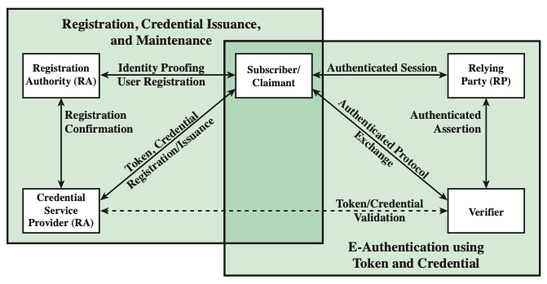
Authentication
The process of establishing confidence in user identities that are presented electronically to an information system
Notes:
NIST SP 800-63-3 (Digital Authentication Guideline , October 2016) defines digital
user authentication as the process of establishing confidence in user identities
that are presented electronically to an information system. Systems can use the
authenticated identity to determine if the authenticated individual is authorized
to perform particular functions, such as database transactions or access to system
resources. In many cases, the authentication and transaction, or other authorized
function, take place across an open network such as the Internet. Equally authentication
and subsequent authorization can take place locally, such as across a local
area network.

Slide 86
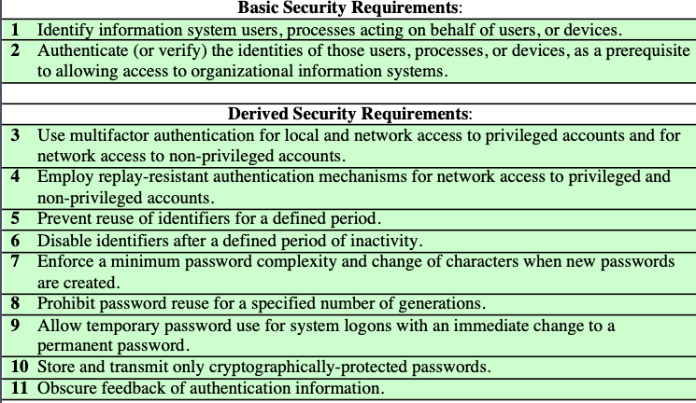
Identification and Authentication Security Requirements
Notes:
NIST SP 800-63-3 (Digital Authentication Guideline , October 2016) defines digital
user authentication as the process of establishing confidence in user identities
that are presented electronically to an information system. Systems can use the
authenticated identity to determine if the authenticated individual is authorized
to perform particular functions, such as database transactions or access to system
resources. In many cases, the authentication and transaction, or other authorized
function, take place across an open network such as the Internet. Equally authentication
and subsequent authorization can take place locally, such as across a local
area network.

Slide 87
Authenticating User Identity - Basis
Something the individual knows
Password, PIN, answers to prearranged questions
Something the individual possesses (token)
Smartphone, electronic keycard, physical key
Something the individual is (static biometrics)
Fingerprint, retina, face
Something the individual does (dynamic biometrics)
Voice pattern, handwriting, typing rhythm
Notes:
There are four general means of authenticating a user's identity, which can be used alone or in combination:
• Something the individual knows: Examples includes a password, a personal identification number (PIN), or answers to a prearranged set of questions.
• Something the individual possesses: Examples include electronic keycards, smart cards, and physical keys. This type of authenticator is referred to as a token.
• Something the individual is (static biometrics): Examples include recognition by fingerprint, retina, and face.
• Something the individual does (dynamic biometrics): Examples include recognition by voice pattern, handwriting characteristics, and typing rhythm.
All of these methods, properly implemented and used, can provide secure user authentication. However, each method has problems. An adversary may be able to guess or steal a password. Similarly, an adversary may be able to forge or steal a token. A user may forget a password or lose a token. Further, there is a significant administrative overhead for managing password and token information on systems and securing such information on systems. With respect to biometric authenticators, there are a variety of problems, including dealing with false positives and false negatives, user acceptance, cost, and convenience.

Slide 88
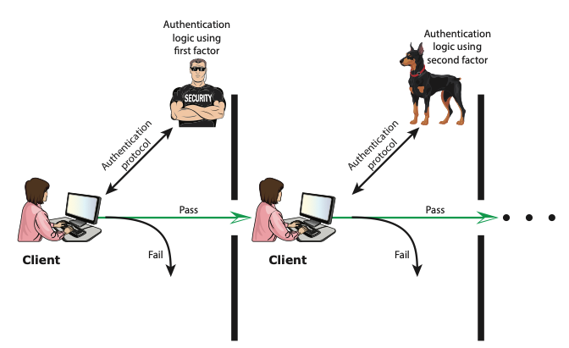
Multi-factor Authentication
Multifactor authentication refers to the use of more than one of the authentication means
Notes:
Multifactor authentication refers to the use
of more than one of the authentication means in the preceding list (see Figure 3.2).
The strength of authentication systems is largely determined by the number of factors
incorporated by the system. Implementations that use two factors are considered to
be stronger than those that use only one factor; systems that incorporate three factors
are stronger than systems that only incorporate two of the factors, and so on.

Slide 89
Risk Assessment for User Authentication
Assurance Level
Potential impact
Areas of risk

Slide 90
Assurance Level
Describes an organization’s degree of certainty that a user has presented a credential that refers to his or her identity
More specifically is defined as:
The degree of confidence in the vetting process used to establish the identity of the individual to whom the credential was issued
The degree of confidence that the individual who uses the credential is the individual to whom the credential was issued
Four levels of assurance
Level 1
Little or no confidence in the asserted identity's validity
Level 2
Some confidence in the asserted identity’s validity
Level 3
High confidence in the asserted identity's validity
Level 4
Very high confidence in the asserted identity’s validity
Notes:
An assurance level describes an organization’s degree of
certainty that a user has presented a credential that refers to his or her identity.
More specifically, assurance is defined as (1) the degree of confidence in the vetting
process used to establish the identity of the individual to whom the credential was
issued and (2) the degree of confidence that the individual who uses the credential is
the individual to whom the credential was issued. SP 800-63-3 recognizes four levels
of assurance:
• Level 1: Little or no confidence in the asserted identity’s validity. An example
of where this level is appropriate is a consumer registering to participate in
a discussion at a company web site discussion board. Typical authentication
technique at this level would be a user-supplied ID and password at the time
of the transaction.
• Level 2: Some confidence in the asserted identity’s validity. Level 2 credentials
are appropriate for a wide range of business with the public where organizations
require an initial identity assertion (the details of which are verified
independently prior to any action). At this level, some sort of secure authentication
protocol needs to be used, together with one of the means of authentication
summarized previously and discussed in subsequent sections.
• Level 3: High confidence in the asserted identity’s validity. This level is appropriate
to enable clients or employees to access restricted services of high value
but not the highest value. An example for which this level is appropriate:
A patent attorney electronically submits confidential patent information to
the U.S. Patent and Trademark Office. Improper disclosure would give competitors
a competitive advantage. Techniques that would need to be used at
this level require more than one factor of authentication; that is, at least two
independent authentication techniques must be used.
• Level 4: Very high confidence in the asserted identity’s validity. This level is
appropriate to enable clients or employees to access restricted services of very
high value or for which improper access is very harmful. For example, a law
enforcement official accesses a law enforcement database containing criminal
records. Unauthorized access could raise privacy issues and/or compromise
investigations. Typically, level 4 authentication requires the use of multiple
factors as well as in-person registration.

Slide 91
Password Cracking
Dictionary attacks
Develop a large dictionary of possible passwords and try each against the password file
Each password must be hashed using each salt value and then compared to stored hash values
Rainbow table attacks
Pre-compute tables of hash values for all salts
A mammoth table of hash values
Can be countered by using a sufficiently large salt value and a sufficiently large hash length
Password crackers exploit the fact that people choose easily guessable passwords
Shorter password lengths are also easier to crack
John the Ripper
Open-source password cracker first developed in in 1996
Uses a combination of brute-force and dictionary techniques
Notes:
The traditional approach to password guessing,
or password cracking as it is called, is to develop a large dictionary of possible
passwords and to try each of these against the password file. This means that
each password must be hashed using each salt value in the password file and then
compared to stored hash values. If no match is found, then the cracking program
tries variations on all the words in its dictionary of likely passwords. Such variations
include backward spelling of words, additional numbers or special characters, or
sequence of characters,
An alternative is to trade off space for time by precomputing potential hash
values. In this approach the attacker generates a large dictionary of possible passwords.
For each password, the attacker generates the hash values associated with
each possible salt value. The result is a mammoth table of hash values known as a
rainbow table. For example, [OECH03] showed that using 1.4 GB of data, he could
crack 99.9% of all alphanumeric Windows password hashes in 13.8 seconds. This
approach can be countered by using a sufficiently large salt value and a sufficiently
large hash length. Both the FreeBSD and OpenBSD approaches should be secure
from this attack for the foreseeable future.
To counter the use of large salt values and hash lengths, password crackers
exploit the fact that some people choose easily guessable passwords. A particular
problem is that users, when permitted to choose their own password, tend to choose
short ones. [BONN12] summarizes the results of a number of studies over the past
few years involving over 40 million hacked passwords, as well as their own analysis
of almost 70 million anonymized passwords of Yahoo! users, and found a tendency
toward six to eight characters of length and a strong dislike of non-alphanumeric
characters in passwords.
The analysis of the 70 million passwords in [BONN12] estimates that passwords
provide fewer than 10 bits of security against an online, trawling attack,
and only about 20 bits of security against an optimal offline dictionary attack. In
other words, an attacker who can manage 10 guesses per account, typically within
the realm of rate-limiting mechanisms, will compromise around 1% of accounts,
just as they would against random 10-bit strings. Against an optimal attacker
performing unrestricted brute force and wanting to break half of all available
accounts, passwords appear to be roughly equivalent to 20-bit random strings.
It can be seen then that using offline search enables an adversary to break
a large number of accounts, even if a significant amount of iterated hashing is
Used.
Password length is only part of the problem. Many people, when permitted
to choose their own password, pick a password that is guessable, such as their
own name, their street name, a common dictionary word, and so forth. This makes
the job of password cracking straightforward. The cracker simply has to test the
password file against lists of likely passwords. Because many people use guessable
passwords, such a strategy should succeed on virtually all systems.
Attacks that use a combination of brute-force and dictionary techniques have
become common. A notable example of this dual approach is John the Ripper, an
open-source password cracker first developed in 1996 and still in use [OPEN13].

Slide 92
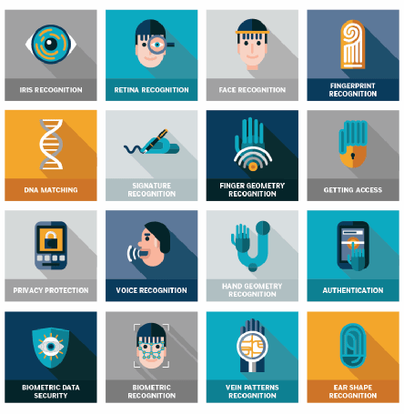
Biometric Authentication
Attempts to authenticate an individual based on unique physical characteristics
Based on pattern recognition
Is technically complex and expensive when compared to passwords and tokens
Physical characteristics used include:
Facial characteristics
Fingerprints
Hand geometry
Retinal pattern
Iris
Signature
Voice
Notes:
A biometric authentication system attempts to authenticate an individual based on
his or her unique physical characteristics. These include static characteristics, such
as fingerprints, hand geometry, facial characteristics, and retinal and iris patterns;
and dynamic characteristics, such as voiceprint and signature. In essence, biometrics
is based on pattern recognition. Compared to passwords and tokens, biometric
authentication is both technically complex and expensive. While it is used in a
number of specific applications, biometrics has yet to mature as a standard tool for
user authentication to computer systems.
A number of different types of physical characteristics are either in use or under
study for user authentication. The most common are the following:
• Facial characteristics: Facial characteristics are the most common means
of human-to-human identification; thus it is natural to consider them for
identification by computer. The most common approach is to define characteristics
based on relative location and shape of key facial features, such as
eyes, eyebrows, nose, lips, and chin shape. An alternative approach is to use an
infrared camera to produce a face thermogram that correlates with the underlying
vascular system in the human face.
• Fingerprints: Fingerprints have been used as a means of identification for
centuries, and the process has been systematized and automated particularly
for law enforcement purposes. A fingerprint is the pattern of ridges and
furrows on the surface of the fingertip. Fingerprints are believed to be unique
across the entire human population. In practice, automated fingerprint recognition
and matching system extract a number of features from the fingerprint
for storage as a numerical surrogate for the full fingerprint pattern.
• Hand geometry: Hand geometry systems identify features of the hand,
including shape, and lengths and widths of fingers.
• Retinal pattern: The pattern formed by veins beneath the retinal surface is
unique and therefore suitable for identification. A retinal biometric system
obtains a digital image of the retinal pattern by projecting a low-intensity
beam of visual or infrared light into the eye.
• Iris: Another unique physical characteristic is the detailed structure of the iris.
• Signature: Each individual has a unique style of handwriting and this is
reflected especially in the signature, which is typically a frequently written
sequence. However, multiple signature samples from a single individual will
not be identical. This complicates the task of developing a computer representation
of the signature that can be matched to future samples.
• Voice: Whereas the signature style of an individual reflects not only the unique
physical attributes of the writer but also the writing habit that has developed,
voice patterns are more closely tied to the physical and anatomical characteristics
of the speaker. Nevertheless, there is still a variation from sample to sample over
time from the same speaker, complicating the biometric recognition task.

Slide 93
Potential Attacks, Susceptible Authenticators, and Typical Defenses
en·tro·py: lack of order or predictability; gradual decline into disorder
Notes:
As with any security service, user authentication, particularly remote user authentication,
is subject to a variety of attacks. Table 3.5, from [OGOR03], summarizes
the principal attacks on user authentication, broken down by type of authenticator.
Much of the table is self-explanatory. In this section, we expand on some of the
table’s entries.

Slide 94
Potential Attacks, Susceptible Authenticators, and Typical Defenses
Notes:
As with any security service, user authentication, particularly remote user authentication,
is subject to a variety of attacks. Table 3.5, from [OGOR03], summarizes
the principal attacks on user authentication, broken down by type of authenticator.
Much of the table is self-explanatory. In this section, we expand on some of the
table’s entries.

Slide 95
Network Scanning and Vulnerability Scanning
Digital Forensics
Cybersecurity Engineering
Security policies
Firewalls
Authentication, Access controls
Federated trust
IoT/Cloud middleware
Module 4 – Defense Architectures and Design

Slide 96
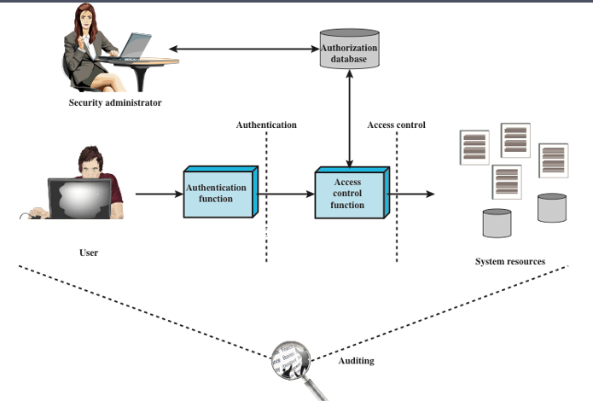
Access Control
Process by which use of system resources is regulated according to a security policy and is permitted only by authorized entities (users, programs, processes, or other systems) according to that policy
Notes:
NIST SP 800-63-3 (Digital Authentication Guideline , October 2016) defines digital
user authentication as the process of establishing confidence in user identities
that are presented electronically to an information system. Systems can use the
authenticated identity to determine if the authenticated individual is authorized
to perform particular functions, such as database transactions or access to system
resources. In many cases, the authentication and transaction, or other authorized
function, take place across an open network such as the Internet. Equally authentication
and subsequent authorization can take place locally, such as across a local
area network.

Slide 97
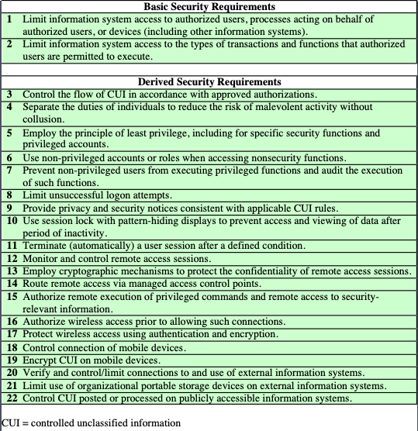
Access Control Security Requirements
Notes:
Table 4.1, from NIST SP 800-171 (Protecting Controlled Unclassified Information
in Nonfederal Information Systems and Organizations , August 2016), provides
a useful list of security requirements for access control services.

Slide 98
Access Control Policies
Discretionary access control (DAC)
Controls access based on the identity of the requestor and on access rules (authorizations) stating what requestors are (or are not) allowed to do
Mandatory access control (MAC)
Controls access based on comparing security labels with security clearances
An entity that has clearance to access a resource may not, just by its own volition, enable another entity to access that resource
Role-based access control (RBAC)
Controls access based on the roles that users have within the system and on rules stating what accesses are allowed to users in given roles
Attribute-based access control (ABAC)
Controls access based on attributes of the user, the resource to be accessed, and current environmental conditions
These four policies are not mutually exclusive; an access control mechanism can employ two or even all three of these policies to cover different classes of system resources
Notes:
An access control policy, which can be embodied in an authorization database,
dictates what types of access are permitted, under what circumstances, and by
whom. Access control policies are generally grouped into the following categories:
• Discretionary access control (DAC): Controls access based on the identity
of the requestor and on access rules (authorizations) stating what requestors
are (or are not) allowed to do. This policy is termed discretionary because an
entity might have access rights that permit the entity, by its own volition, to
enable another entity to access some resource.
• Mandatory access control (MAC): Controls access based on comparing
security labels (which indicate how sensitive or critical system resources are)
with security clearances (which indicate system entities are eligible to access
certain resources). This policy is termed mandatory because an entity that has
clearance to access a resource may not, just by its own volition, enable another
entity to access that resource.
• Role-based access control (RBAC): Controls access based on the roles that
users have within the system and on rules stating what accesses are allowed to
users in given roles.
• Attribute-based access control (ABAC): Controls access based on attributes
of the user, the resource to be accessed, and current environmental
conditions.
DAC is the traditional method of implementing access control, and is examined
in Sections 4.3 and 4.4. MAC is a concept that evolved out of requirements for
military information security and is best covered in the context of trusted systems,
which we deal with in Chapter 27. Both RBAC and ABAC have become increasingly
popular, and are examined in Sections 4.5 and 4.6, respectively.
These four policies are not mutually exclusive. An access control mechanism
can employ two or even all three of these policies to cover different classes of system
resources.

Slide 99
Subjects, Objects, and Access Rights
Subject
An entity capable of accessing objects
Three classes
Owner
Group
World
Object
A resource to which access is controlled
Entity used to contain and/or receive information
Access right
Describes the way in which a subject may access an object
Could include:
Read
Write
Execute
Delete
Create
Search
Notes:
The basic elements of access control are: subject, object, and access right.
A subject is an entity capable of accessing objects. Generally, the concept of
subject equates with that of process. Any user or application actually gains access to
an object by means of a process that represents that user or application. The process
takes on the attributes of the user, such as access rights.
A subject is typically held accountable for the actions they have initiated,
and an audit trail may be used to record the association of a subject with security relevant
actions performed on an object by the subject.
Basic access control systems typically define three classes of subject, with
different access rights for each class:
• Owner: This may be the creator of a resource, such as a file. For system resources,
ownership may belong to a system administrator. For project resources, a project
administrator or leader may be assigned ownership.
• Group: In addition to the privileges assigned to an owner, a named group of
users may also be granted access rights, such that membership in the group is
sufficient to exercise these access rights. In most schemes, a user may belong
to multiple groups.
• World: The least amount of access is granted to users who are able to access the
system but are not included in the categories owner and group for this resource.
An object is a resource to which access is controlled. In general, an object
is an entity used to contain and/or receive information. Examples include records,
blocks, pages, segments, files, portions of files, directories, directory trees, mailboxes,
messages, and programs. Some access control systems also encompass, bits,
bytes, words, processors, communication ports, clocks, and network nodes.
The number and types of objects to be protected by an access control system
depends on the environment in which access control operates and the desired tradeoff
between security on the one hand and complexity, processing burden, and ease
of use on the other hand.
An access right describes the way in which a subject may access an object.
Access rights could include the following:
• Read: User may view information in a system resource (e.g., a file, selected
records in a file, selected fields within a record, or some combination). Read
access includes the ability to copy or print.
• Write: User may add, modify, or delete data in system resource (e.g., files,
records, programs). Write access includes read access.
• Execute: User may execute specified programs.
• Delete: User may delete certain system resources, such as files or records.
• Create: User may create new files, records, or fields.
• Search: User may list the files in a directory or otherwise search the directory.

Slide 100
Discretionary Access Control (DAC)
Scheme in which an entity may be granted access rights that permit the entity, by its own violation, to enable another entity to access some resource
Often provided using an access matrix
One dimension consists of identified subjects that may attempt data access to the resources
The other dimension lists the objects that may be accessed
Each entry in the matrix indicates the access rights of a particular subject for a particular object
Notes:
As was previously stated, a discretionary access control scheme is one in which an
entity may be granted access rights that permit the entity, by its own volition, to
enable another entity to access some resource. A general approach to DAC, as
exercised by an operating system or a database management system, is that of an
access matrix. The access matrix concept was formulated by Lampson [LAMP69,
LAMP71], and subsequently refined by Graham and Denning [GRAH72, DENN71]
and by Harrison et al. [HARR76].
One dimension of the matrix consists of identified subjects that may attempt
data access to the resources. Typically, this list will consist of individual users or
user groups, although access could be controlled for terminals, network equipment,
hosts, or applications instead of or in addition to users. The other dimension lists
the objects that may be accessed. At the greatest level of detail, objects may be
individual data fields. More aggregate groupings, such as records, files, or even the
entire database, may also be objects in the matrix. Each entry in the matrix indicates
the access rights of a particular subject for a particular object.

Slide 101
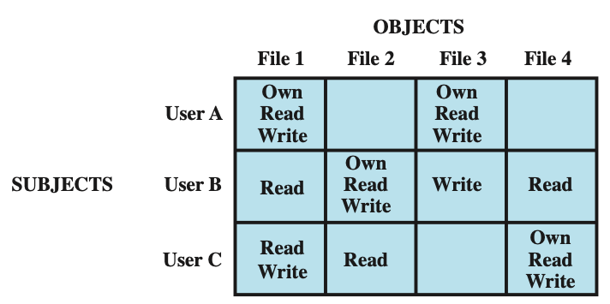
Access Control Structures Example
Access Matrix
User A owns files 1 and 3 and has read and write access rights to those
files. User B has read access rights to file 1, and so on.
Notes:
Figure 4.2a, based on a figure in [SAND94], is a simple example of an access
matrix. Thus, user A owns files 1 and 3 and has read and write access rights to those
files. User B has read access rights to file 1, and so on.

Slide 102
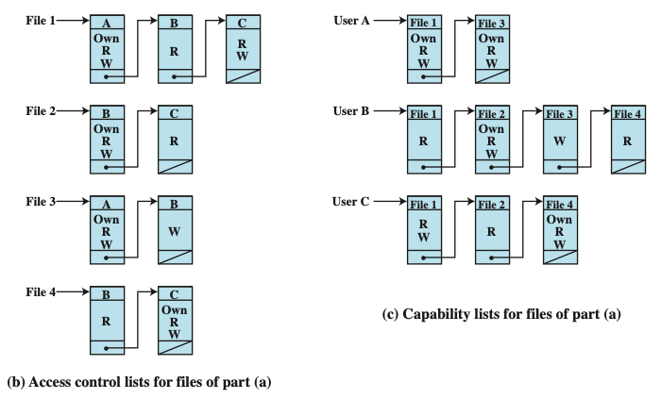
Access Control Lists
The access matrix may be decomposed by columns, yielding access control lists (ACLs)
For each object, an ACL lists users and their permitted access rights. The ACL may contain a default, or public, entry. This allows users that are not explicitly listed as having special rights to have a default set of rights. The default set of rights should always follow the rule of least privilege or read-only access, whichever is applicable. Elements of the list may include individual users as well as groups of users.
Notes:
In practice, an access matrix is usually sparse and is implemented by decomposition in one of two ways. The matrix may be decomposed by columns, yielding access control lists (ACLs); see Figure 4.2b. For each object, an ACL lists users and their permitted access rights. The ACL may contain a default, or public, entry. This allows users that are not explicitly listed as having special rights to have a default set of rights. The default set of rights should always follow the rule of least privilege or read-only access, whichever is applicable. Elements of the list may include individual users as well as groups of users.
When it is desired to determine which subjects have which access rights to a particular resource, ACLs are convenient, because each ACL provides the information for a given resource. However, this data structure is not convenient for determining the access rights available to a specific user.
Decomposition by rows yields capability tickets (Figure 4.2c). A capability
ticket specifies authorized objects and operations for a particular user. Each user
has a number of tickets and may be authorized to loan or give them to others.
Because tickets may be dispersed around the system, they present a greater
security problem than access control lists. The integrity of the ticket must be
protected, and guaranteed (usually by the operating system). In particular, the
ticket must be unforgeable. One way to accomplish this is to have the operating
system hold all tickets on behalf of users. These tickets would have to be held in
a region of memory inaccessible to users. Another alternative is to include an
unforgeable token in the capability. This could be a large random password, or a
cryptographic message authentication code. This value is verified by the relevant
resource whenever access is requested. This form of capability ticket is appropriate
for use in a distributed environment, when the security of its contents cannot
be guaranteed.
The convenient and inconvenient aspects of capability tickets are the opposite
of those for ACLs. It is easy to determine the set of access rights that a given user
has, but more difficult to determine the list of users with specific access rights for a
specific resource.

Slide 103
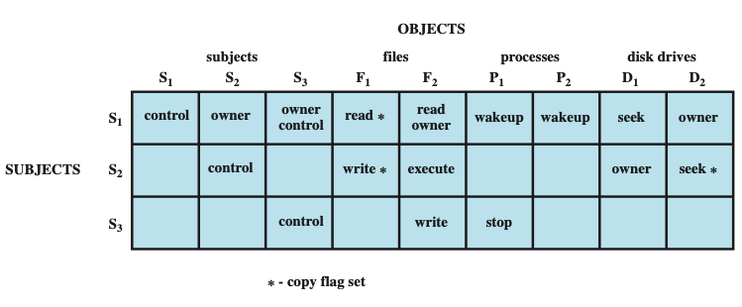
Extended Access Control Matrix
To represent the protection state, we extend the universe of objects in the access control matrix to include the following:
Processes: Access rights include the ability to delete a process, stop (block), and wake up a process
Devices: Access rights include the ability to read/write the device, to control its operation (e.g., a disk seek), and to block/unblock the device for use
Memory locations or regions: Access rights include the ability to read/write certain regions of memory that are protected such that the default is to disallow access
Subjects: Access rights with respect to a subject have to do with the ability to grantor delete access rights of that subject to other objects, as explained subsequently
Notes:
This section introduces a general model for DAC developed by Lampson, Graham,
and Denning [LAMP71, GRAH72, DENN71]. The model assumes a set of subjects,
a set of objects, and a set of rules that govern the access of subjects to objects. Let us
define the protection state of a system to be the set of information, at a given point in
time, that specifies the access rights for each subject with respect to each object. We can
identify three requirements: representing the protection state, enforcing access rights,
and allowing subjects to alter the protection state in certain ways. The model addresses
all three requirements, giving a general, logical description of a DAC system.
To represent the protection state, we extend the universe of objects in the
access control matrix to include the following:
• Processes: Access rights include the ability to delete a process, stop (block),
and wake up a process.
• Devices: Access rights include the ability to read/write the device, to control
its operation (e.g., a disk seek), and to block/unblock the device for use.
• Memory locations or regions: Access rights include the ability to read/write
certain regions of memory that are protected such that the default is to disallow
access.
• Subjects: Access rights with respect to a subject have to do with the ability to grant
or delete access rights of that subject to other objects, as explained subsequently.
Figure 4.3 is an example. For an access control matrix A, each entry A[S, X]
contains strings, called access attributes, that specify the access rights of subject S to
object X. For example, in Figure 4.3, S₁ may read file F₁, because ‘read’ appears in
A[S₁, F₁].
From a logical or functional point of view, a separate access control module is
associated with each type of object (Figure 4.4). The module evaluates each request
by a subject to access an object to determine if the access right exists. An access
attempt triggers the following steps:
1. A subject S₀ issues a request of type α for object X.
2. The request causes the system (the operating system or an access control interface
module of some sort) to generate a message of the form (S₀, α, X) to the
controller for X.
3. The controller interrogates the access matrix A to determine if α is in A[S₀, X].
If so, the access is allowed; if not, the access is denied and a protection violation
occurs. The violation should trigger a warning and appropriate action.

Slide 104
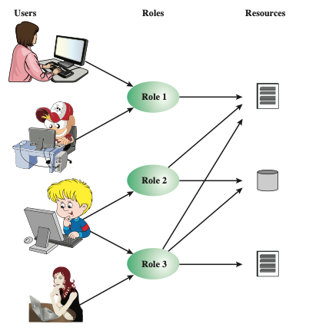
Role-Based Access Control
Traditional DAC systems define the access rights of individual users and groups of users
In contrast, RBAC is based on the roles that users assume in a system rather than the user’s identity
Typically, RBAC models define a role as a job function within an organization
RBAC systems assign access rights to roles instead of individual users
In turn, users are assigned to different roles, either statically or dynamically, according to their responsibilities
Users, Roles and Resources
Notes:
Traditional DAC systems define the access rights of individual users and groups
of users. In contrast, RBAC is based on the roles that users assume in a system
rather than the user’s identity. Typically, RBAC models define a role as a job function
within an organization. RBAC systems assign access rights to roles instead of
individual users. In turn, users are assigned to different roles, either statically or
dynamically, according to their responsibilities.
RBAC now enjoys widespread commercial use and remains an area of active
research. The National Institute of Standards and Technology (NIST) has issued a
standard, FIPS PUB 140-3, (Security Requirements for Cryptographic Modules September 2009),
that requires support for access control and administration through roles.
The relationship of users to roles is many to many, as is the relationship of
roles to resources, or system objects (Figure 4.6). The set of users changes, in some
environments frequently, and the assignment of a user to one or more roles may
also be dynamic. The set of roles in the system in most environments is relatively
static, with only occasional additions or deletions. Each role will have specific access
rights to one or more resources. The set of resources and the specific access rights
associated with a particular role are also likely to change infrequently.

Slide 105
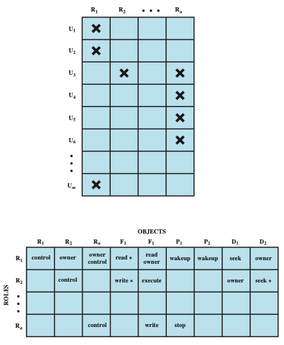
Access Control Matrix in RBAC
Notes:
We can use the access matrix representation to depict the key elements of an
RBAC system in simple terms, as shown in Figure 4.7. The upper matrix relates
individual users to roles. Typically there are many more users than roles. Each matrix
entry is either blank or marked, the latter indicating that this user is assigned to this
role. Note that a single user may be assigned multiple roles (more than one mark in a
row) and that multiple users may be assigned to a single role (more than one mark in
a column). The lower matrix has the same structure as the DAC access control matrix,
with roles as subjects. Typically, there are few roles and many objects, or resources.
In this matrix the entries are the specific access rights enjoyed by the roles. Note that a
role can be treated as an object, allowing the definition of role hierarchies.
RBAC lends itself to an effective implementation of the principle of least
privilege, referred to in Chapter 1. Each role should contain the minimum set of
access rights needed for that role. A user is assigned to a role that enables him or her
to perform only what is required for that role. Multiple users assigned to the same
role, enjoy the same minimal set of access rights.

Slide 106
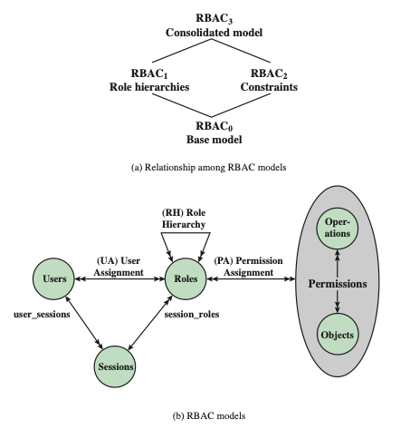
RBAC Models
Best Practice: Auth0
Notes:
A variety of functions and services can be included under the general RBAC
approach. To clarify the various aspects of RBAC, it is useful to define a set of
abstract models of RBAC functionality.
[SAND96] defines a family of reference models that has served as the basis
for ongoing standardization efforts. This family consists of four models that are
related to each other as shown in Figure 4.8a. and Table 4.4. RBAC₀ contains the
minimum functionality for an RBAC system. RBAC₁ includes the RBAC₀ functionality
and adds role hierarchies, which enable one role to inherit permissions
from another role. RBAC₂ includes RBAC₀ and adds constraints, which restrict
the ways in which the components of a RBAC system may be configured. RBAC₃
contains the functionality of RBAC₀, RBAC₁, and RBAC₂.
RBAC₀ Figure 4.8b, without the role hierarchy and constraints,
contains the four types of entities in an RBAC₀ system:
• User: An individual that has access to this computer system. Each individual
has an associated user ID.
Role: A named job function within the organization that controls this computer
system. Typically, associated with each role is a description of the authority and
responsibility conferred on this role, and on any user who assumes this role.
• Permission: An approval of a particular mode of access to one or more objects.
Equivalent terms are access right, privilege, and authorization.
• Session: A mapping between a user and an activated subset of the set of roles
to which the user is assigned.
The arrowed lines in Figure 4.8b indicate relationships, or mappings, with a
single arrowhead indicating one and a double arrowhead indicating many. Thus,
there is a many-to-many relationship between users and roles: One user may have
multiple roles, and multiple users may be assigned to a single role. Similarly, there
is a many-to-many relationship between roles and permissions. A session is used to
define a temporary one-to-many relationship between a user and one or more of the
roles to which the user has been assigned. The user establishes a session with only the
roles needed for a particular task; this is an example of the concept of least privilege.
The many-to-many relationships between users and roles and between roles
and permissions provide a flexibility and granularity of assignment not found in
conventional DAC schemes. Without this flexibility and granularity, there is a greater
risk that a user may be granted more access to resources than is needed because
of the limited control over the types of access that can be allowed. The NIST RBAC
document gives the following examples: Users may need to list directories and modify
existing files without creating new files, or they may need to append
records to a file without modifying existing records.

Slide 107
Attribute-Based Access Control
Can define authorizations that express conditions on properties of both the resource and the subject
Strength is its flexibility and expressive power
Main obstacle to its adoption in real systems has been concern about the performance impact of evaluating predicates on both resource and user properties for each access
Web services have been pioneering technologies through the introduction of the eXtensible Access Control Markup Language (XAMCL)
There is considerable interest in applying the model to cloud services
Notes:
A relatively recent development in access control technology is the attribute-based
access control (ABAC) model. An ABAC model can define authorizations that
express conditions on properties of both the resource and the subject. For example,
consider a configuration in which each resource has an attribute that identifies the
subject that created the resource. Then, a single access rule can specify the ownership
privilege for all the creators of every resource. The strength of the ABAC
approach is its flexibility and expressive power. [PLAT13] points out that the main
obstacle to its adoption in real systems has been concern about the performance
impact of evaluating predicates on both resource and user properties for each
access. However, for applications such as cooperating Web services and cloud computing,
this increased performance cost is less noticeable because there is already a
relatively high performance cost for each access. Thus, Web services have been pioneering
technologies for implementing ABAC models, especially through the introduction
of the eXtensible Access Control Markup Language (XAMCL) [BEUC13],
and there is considerable interest in applying the ABAC model to cloud services
[IQBA12, YANG12].
There are three key elements to an ABAC model: attributes, which are defined
for entities in a configuration; a policy model, which defines the ABAC policies; and
the architecture model, which applies to policies that enforce access control. We
examine these elements in turn.

Slide 108
ABAC Model Attributes
Subject attributes
A subject is an active entity that causes information to flow among objects or changes the system state
Object attributes
An object (or resource) is a passive information system-related entity containing or receiving information
Environment attributes
Describe the operational, technical, and even situational environment or context in which the information access occurs
Attributes define the identity and characteristics of the subject
Objects have attributes that can be leverages to make access control decisions
These attributes have so far been largely ignored in most access control policies
Notes:
Attributes are characteristics that define specific aspects of the subject, object, environment
conditions, and/or requested operations that are predefined and preassigned
by an authority. Attributes contain information that indicates the class of information
given by the attribute, a name, and a value (e.g., Class=HospitalRecordsAccess,
Name=PatientInformationAccess, Value=MFBusinessHoursOnly).
The following are the three types of attributes in the ABAC model:
• Subject attributes: A subject is an active entity (e.g., a user, an application, a
process, or a device) that causes information to flow among objects or changes
the system state. Each subject has associated attributes that define the identity
and characteristics of the subject. Such attributes may include the subject’s
identifier, name, organization, job title, and so on. A subject’s role can also be
viewed as an attribute.
• Object attributes: An object, also referred to as a resource , is a passive (in the
context of the given request) information system-related entity (e.g., devices,
files, records, tables, processes, programs, networks, domains) containing or
receiving information. As with subjects, objects have attributes that can be
leveraged to make access control decisions. A Microsoft Word document, for
example, may have attributes such as title, subject, date, and author. Object
attributes can often be extracted from the metadata of the object. In particular,
a variety of Web service metadata attributes may be relevant for access
control purposes, such as ownership, service taxonomy, or even Quality of
Service (QoS) attributes.
• Environment attributes: These attributes have so far been largely ignored in
most access control policies. They describe the operational, technical, and even
situational environment or context in which the information access occurs. For
example, attributes, such as current date and time, the current virus/hacker
activities, and the network’s security level (e.g., Internet vs. intranet), are not
associated with a particular subject nor a resource, but may nonetheless be
relevant in applying an access control policy.

Slide 109
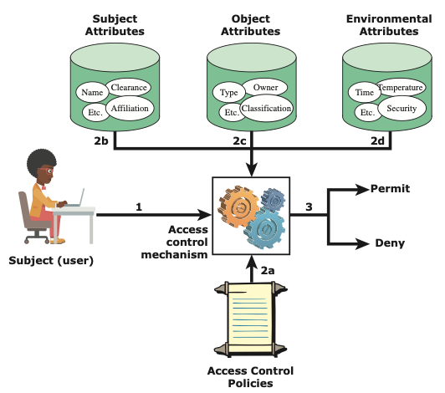
ABAC Scenario
It is clear from the logical architecture that there are four independent sources of information used for the access control decision. The system designer can decide which attributes are important for access control with respect to subjects, objects, and environmental conditions. The system designer or other authority can then define access control policies, in the form of rules, for any desired combination of attributes of subject, object, and environmental conditions.
Notes:
Figure 4.10 illustrates in a logical architecture the essential components of an ABAC
system. An access by a subject to an object proceeds according to the following steps:
1. A subject requests access to an object. This request is routed to an access control
mechanism.
2. The access control mechanism is governed by a set of rules (2a) that are defined
by a preconfigured access control policy. Based on these rules, the access control
mechanism assesses the attributes of the subject (2b), object (2c), and current
environmental conditions (2d) to determine authorization.
3. The access control mechanism grants the subject access to the object if access
is authorized and denies access if it is not authorized.
It is clear from the logical architecture that there are four independent sources
of information used for the access control decision. The system designer can decide
which attributes are important for access control with respect to subjects, objects,
and environmental conditions. The system designer or other authority can then
define access control policies, in the form of rules, for any desired combination of
attributes of subject, object, and environmental conditions. It should be evident that
this approach is very powerful and flexible. However, the cost, both in terms of
the complexity of the design and implementation and in terms of the performance
impact, is likely to exceed that of other access control approaches. This is a tradeoff
that the system authority must make.

Slide 110
ABAC Distinguishable Characteristics
Distinguishable because it controls access to objects by evaluating rules against the attributes of entities, operations, and the environment relevant to a request
Relies upon the evaluation of attributes of the subject, attributes of the object, and a formal relationship or access control rule defining the allowable operations for subject-object attribute combinations in a given environment
Systems are capable of enforcing DAC, RBAC, and MAC concepts
Allows an unlimited number of attributes to be combined to satisfy any access control rule
Apply ABAC if
You’re in a large organization with many users
You want deep, specific access control capabilities
You have time to invest in a model that goes the distance
You need to ensure privacy and security compliance
Notes:
ABAC is a logical access control model that is distinguishable because it controls
access to objects by evaluating rules against the attributes of entities (subject
and object), operations, and the environment relevant to a request. ABAC relies
upon the evaluation of attributes of the subject, attributes of the object, and a formal
relationship or access control rule defining the allowable operations for subject-object
attribute combinations in a given environment. All ABAC solutions contain
these basic core capabilities to evaluate attributes and enforce rules or relationships
between those attributes. ABAC systems are capable of enforcing DAC, RBAC,
and MAC concepts. ABAC enables fine-grained access control, which allows for a
higher number of discrete inputs into an access control decision, providing a bigger
set of possible combinations of those variables to reflect a larger and more definitive
set of possible rules, policies, or restrictions on access. Thus, ABAC allows an
unlimited number of attributes to be combined to satisfy any access control rule.
Moreover, ABAC systems can be implemented to satisfy a wide array of requirements
from basic access control lists through advanced expressive policy models
that fully leverage the flexibility of ABAC.

Slide 111
Enterprise-wide Access Control
Resource management
Concerned with defining rules for a resource that requires access control
Rules would include credential requirements and what user attributes, resource attributes, and environmental conditions are required for access of a given resource for a given function
Privilege management
Concerned with establishing and maintaining the entitlement or privilege attributes that comprise an individual’s access profile
These attributes represent features of an individual that can be used as the basis for determining access decisions to both physical and logical resources
Privileges are considered attributes that can be linked to a digital identity
Policy management
Governs what is allowable and unallowable in an access transaction
Notes:
Three support elements
are needed for an enterprise-wide access control facility:
• Resource management: This element is concerned with defining rules for
a resource that requires access control. The rules would include credential
requirements and what user attributes, resource attributes, and environmental
conditions are required for access of a given resource for a given
function.
• Privilege management: This element is concerned with establishing and maintaining
the entitlement or privilege attributes that comprise an individual’s
access profile. These attributes represent features of an individual that can be
used as the basis for determining access decisions to both physical and logical
resources. Privileges are considered attributes that can be linked to a digital
identity.
• Policy management: This element governs what is allowable and unallowable
in an access transaction. That is, given the identity and attributes of
the requestor, the attributes of the resource or object, and environmental
conditions, a policy specifies what actions this user can perform on this
object.

Slide 112
Network Scanning and Vulnerability Scanning
Digital Forensics
Cybersecurity Engineering
Security policies
Firewalls
Authentication, Access controls
Federated trust
IoT/Cloud middleware
Module 4 – Defense Architectures and Design

Slide 113
OAuth 2.0 Intro.
OAuth 2 is an authorization framework that enables applications — such as Facebook, GitHub, and DigitalOcean — to obtain limited access to user accounts on an HTTP service.
It works by delegating user authentication to the service that hosts a user account and authorizing third-party applications to access that user account.
OAuth 2 provides authorization flows for web and desktop applications, as well as mobile devices.

Slide 114
OAuth Roles
OAuth defines four roles:
Resource Owner: The resource owner is the user who authorizes an application to access their account. The application’s access to the user’s account is limited to the scope of the authorization granted (e.g. read or write access)
Client: The client is the application that wants to access the user’s account. Before it may do so, it must be authorized by the user, and the authorization must be validated by the API.
Resource Server: The resource server hosts the protected user accounts.
Authorization Server: The authorization server verifies the identity of the user then issues access tokens to the application.

Slide 115
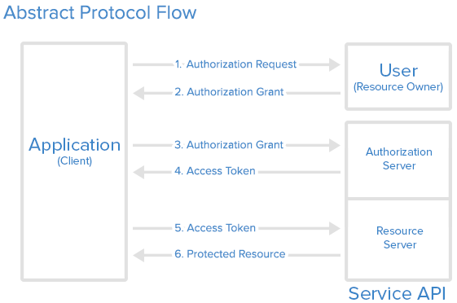
OAuth Steps

Slide 116
OAuth service steps
Application Registration
Application Name
Application Website
Redirect URI or Callback URL
Authorization Grant – Various Types
Authorization Code: used with server-side Applications
Client Credentials: used with Applications that have API access
Device Code: used for devices that lack browsers or have input limitations

Slide 117
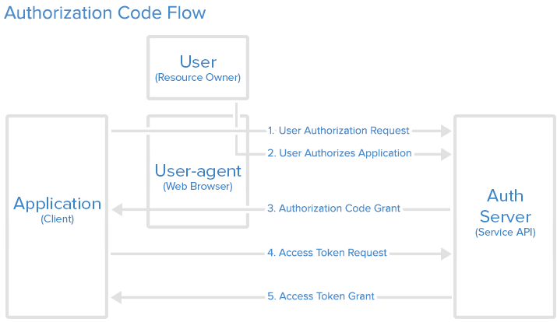
Most used Grant Type: Authorization Code

Slide 118
Network Scanning and Vulnerability Scanning
Digital Forensics
Cybersecurity Engineering
Security policies
Firewalls
Authentication, Access controls
Federated trust
IoT/Cloud middleware
Module 4 – Defense Architectures and Design

Slide 119
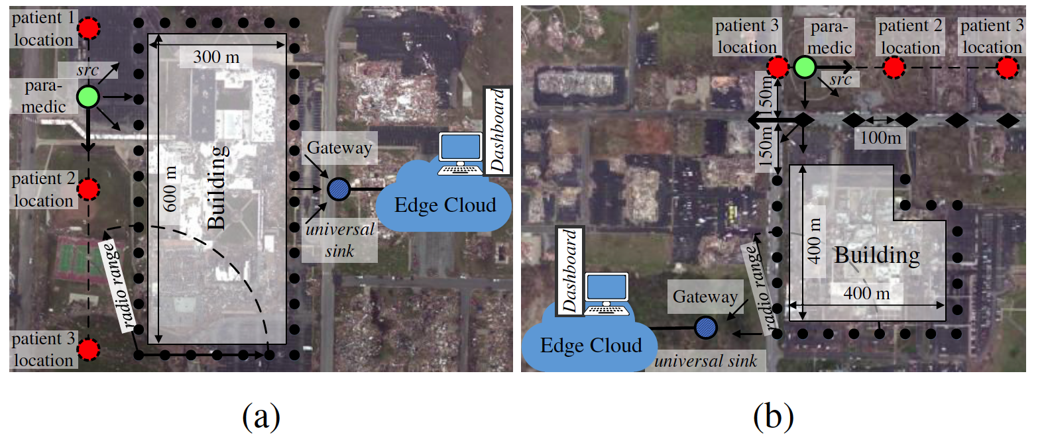
Lightweight and Flexible Security for IoT-based Smart City Applications
Recreated disaster scenes of tornado damages (in Joplin, MO 2011) at the: (a) Joplin High School; (b) Joplin Hospital

Slide 120
Lightweight and Flexible Security for IoT-based Smart City Applications
IoT Gateway Middleware that uses machine learning to decide on tradeoffs in energy, latency and security in deciding computing policies at core or edge
B. Mukherjee, S. Wang, W. Lu, R. Neupane, D. Dunn, Y. Ren, Q. Su, P. Calyam, “Flexible IoT Security Middleware for End-to-End Cloud-Fog Communication”, Elsevier Future Generation Computer Systems (FGCS) – Special Issue on Internet of Things (IoT): Operating System, Applications and Protocols Design, and Validation Techniques, 2018.

Slide 121
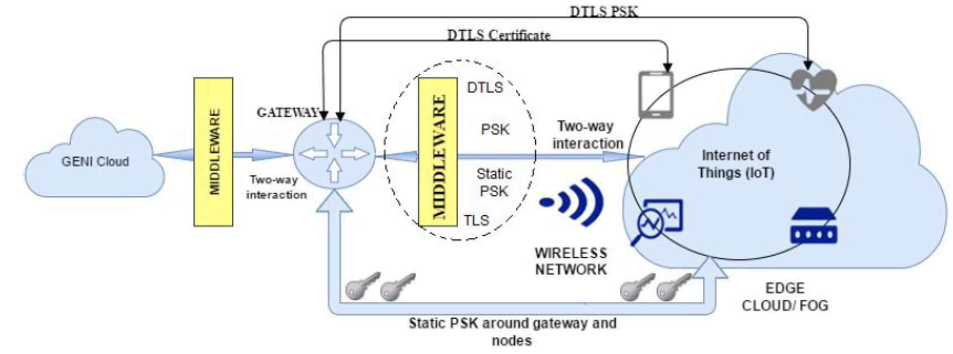
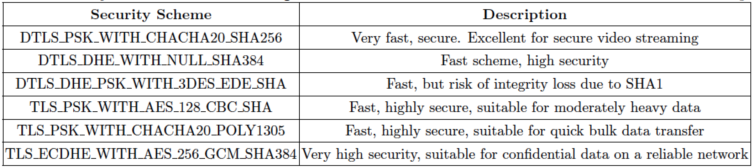
Resource-aware IoT Security Middleware for End-to-End Cloud-Fog Communication
Gateway-hosted middleware stores and tracks sessions, certificates or keys between the fog and cloud entities
Decouples services and protocols for end-to-end security using static pre-shared keys for quick encryption setup
Selection of security protocols to be used based on resource-awareness

Slide 122
Introduction to Cloud Computing
Security on Cloud Services
Cloud Storage Security
Cloud Application Security and Access Control
Introduction to Internet of Things
IoT Security and Cloud
Module 5 – Cloud and IoT Security

Slide 123
Introduction to Cloud Computing
Security on Cloud Services
Cloud Storage Security
Cloud Application Security and Access Control
Introduction to Internet of Things
IoT Security and Cloud
Module 5 – Cloud and IoT Security

Slide 124
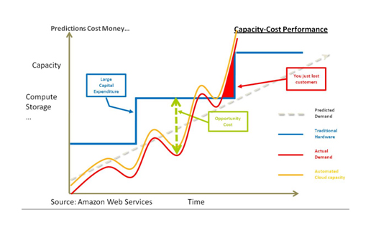
The Story of Amazon EC2
Amazon wanted to utilize their resources more efficiently
So that developers wouldn't need to procure hardware
Cloud means they didn't need to provision dedicated resource capacity for each type of system
They just needed to pull from the resource pool
Still, there was a need for sufficient peak capacity (such as during holidays), so a large amount of hardware wasn't in use every day.
Renting out spare capacity (EC2)
The public AWS is a separate project, not leasing core capabilities, but all of Amazon's business runs on top of it
Notes:
Telling the story of the Amazon’s entrance into the cloud computing business is an interesting way to begin the day, to provide real context for how cloud computing works and show the evolution of Amazon’s experience.
At it’s core, it’s an efficiency play. Amazon needed to make better use of their resources, since they had to provision enough resources for Black Friday (the biggest shopping day of the year in the US), which wasn’t used particularly effectively the rest of the year. They also wanted their developers to get things done, as opposed to fight with IT about provisioning resources. Amazon’s flavor of cloud allowed resources to be pulled from their core computing pool in a self-service model. Remember that fact, as self-service becomes important later in the module.
Finally Amazon figured they could leverage these technologies to provide a public platform and build a profitable business. As of early 2015, AWS was a $5B business, with over $260M in profits.

Slide 125

Resource Pools
Storage Resources
Network Resources
Computing Resources
Notes:
The concept of resource pools is a critical aspect of cloud computing. The idea is that a service provider (or multiple service providers) will have many distinct resources available for compute (CPU), networks, and storage. These may be in one data center, or many. It could be in one geographic area, or many. To the customer, the location of any of the resources isn’t important. The customer only wants to be able to get access to the computing resources they need (compute, networking, storage) to make it all work together.
Thus they mix and match resources that exist within these resource pools to deliver what they need to meet the applications demands. And the idea is these allocations are fungible and will change over time.

Slide 126
What is Cloud Computing?
Applications and commodity computing resources (storage, CPU, networking, etc.) are separated in the cloud model. So the idea of managing actually servers and provisioning storage and dealing with network connectivity is no longer an issue.
Another aspect of cloud computing is flexibility, since computing resources are organized into “pools” this allows customers to buy what they need. However they want to buy it.
These so-called pools can be instantly provisioned and rolled-out (or deprovisioned and taken offline) meaning there aren’t constraints to how quickly the infrastructure can be changed.
Cloud resources can be scaled up and/or down with ease, providing a customer the ability to scale their environment based on usage, not based on hardware.
Notes:
One of the biggest challenges of security cloud computing is to just understand what cloud computing is. Here are four aspects of the cloud that should clarify things a bit.
Applications and commodity computing resources (storage, CPU, networking, etc.) are separated in the cloud model. So the idea of managing actually servers and provisioning storage and dealing with network connectivity is no longer an issue.
Another aspect of cloud computing is flexibility, since computing resources are organized into “pools” this allows customers to buy what they need. However they want to buy it.
These so-called pools can be instantly provisioned and rolled-out (or deprovisioned and taken offline) meaning there aren’t constraints to how quickly the infrastructure can be changed.
Cloud resources can be scaled up and/or down with ease, providing a customer the ability to scale their environment based on usage, not based on hardware.

Slide 127
Potential benefits
Of Cloud Computing
Agility Resiliency Economics
No Capital Expenditures
More Agility
Unbounded Scale
Improved Resource Utilization
Customer-controlled Migration
Resilience
Pay for Use
Notes:
The main potential benefits are better agility, resiliency, and economics. But only if you adapt your architectures to match the requirements of the cloud. Otherwise you will be less agile, less resilient, and it will cost more.
The benefits of cloud computing are still being defined, but here are a few areas where embracing the cloud can definitely have an impact on IT operations.
No Capital Expenditures – Cloud computing removes the need for a company to invest in a physical data center. It’s the providers problem to build (and manage) the facility, provision power, network connectivity, and the like. The customer just pays a monthly charge for what they use.
More Agility – Without having to deal with physically implementing hardware, customers can roll out new applications and/or scale existing environments instantly. Provisioning hardware infrastructure ceases to be an impediment to rolling out new technology capabilities.
Unbounded Scale – Cloud providers don’t run out of space in the racks. They don’t have power constraints. They don’t need to wait for their storage vendor to send another array. Or maybe they do, but that’s not the customer’s problem anymore. The customer expect to and can scale their environment to whatever degree they need to (and can afford).
Improved Resource Utilization – Since all infrastructure (compute, networks, storage, etc.) are shared amongst all customers, this provides a better utilization of hardware resources. Again, the customer isn’t worried about that (since they get what they want when they want it), but it allows the provider to deliver a service at a lower cost, since they are using their resources more efficiently.
Customer-controlled Migration – Customers can use the cloud to whatever degree makes sense for their application. They can build (or move) the entire environment in the cloud, they can use the cloud for capacity at peak usage times, or they can use the cloud to add more locations or additional resources to supplement internal resources. The architecture of a cloud provider allows the customer to figure out what makes sense for them at any given time, without locking them into a specific division of computing resources.
Resilience – Cloud environments are architected to eliminate single points of failure and are built specifically with resilience in mind. Do cloud providers go down? Yes. But given the number of other customers using the resources, the provider is going to move to restore service with urgency. The data centers are monitored 24/7 and each device is managed with sophisticated software to ensure maximum uptime.
Pay for Use – If a customer needs another server, you launch another instance and pay for it. If you need to provision a separate network segment, you do that also and pay for it. If you need another TB of storage to scale an application, you can provision that and add the volume where it’s needed. And you pay for that. But you don’t pay for what you don’t need, and what you don’t use.

Slide 128
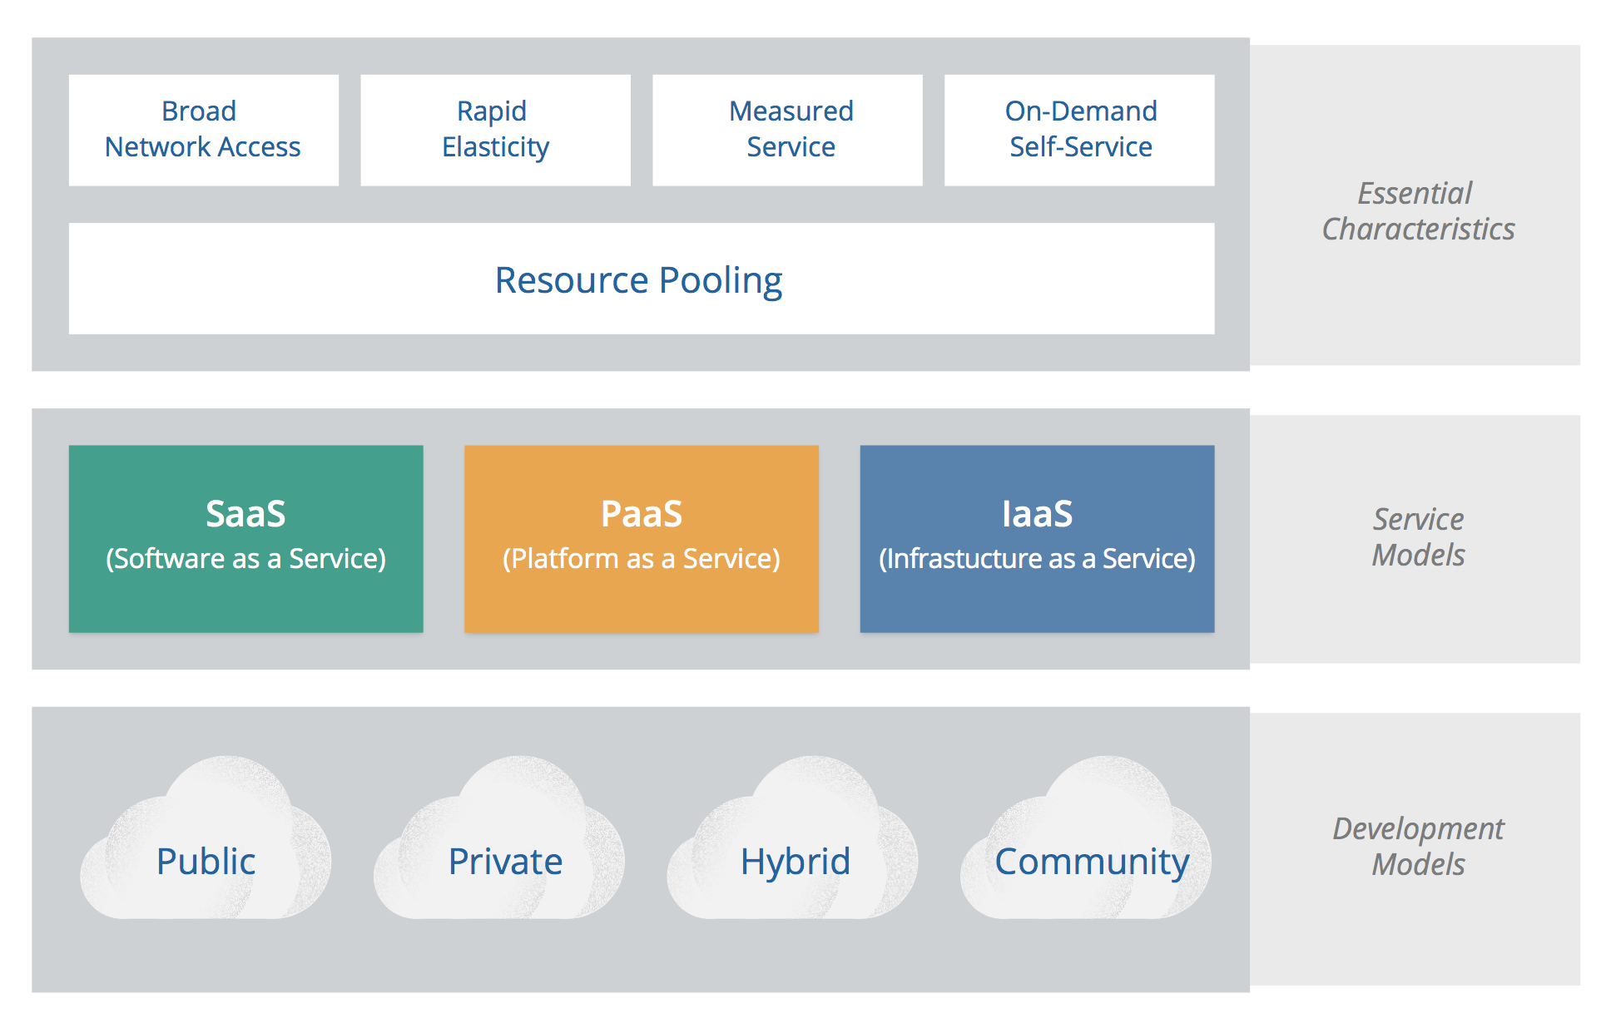
NIST Cloud Computing Model
Notes:
NIST’s publication is generally well accepted, and the CSA has chosen to align with the NIST Working Definition of cloud computing (version 15 as of this writing) to bring coherence and consensus around a common language so we can focus on use cases rather than semantic nuance. It is important to note that this guide is intended to be broadly usable and applicable to organizations globally. While NIST is a U.S. government organization, the selection of this reference model should not be interpreted to suggest the exclusion of other points of view or geographies. NIST defines cloud computing by describing five essential characteristics, three cloud service models, and four cloud deployment models. They are summarized in visual form in figure 1 and explained throughout the rest of this module.

Slide 129
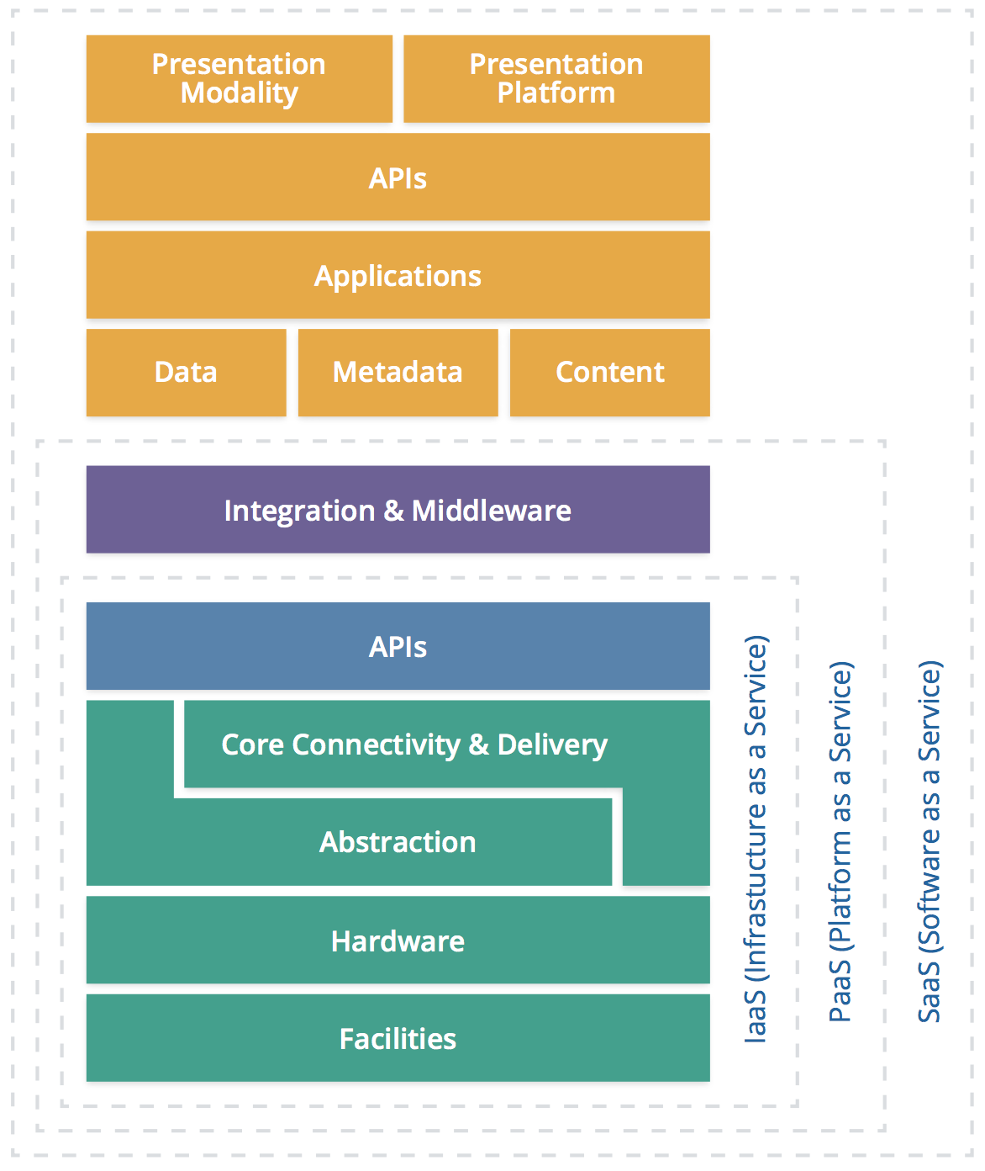
Cloud Service
The SPI stack.
S for Software as a Service.
P for Platform as a Service.
I for Infrastructure as a Service.
Notes:
In terms of what you buy when you look at cloud services, the types of offerings tend to broken up into three different levels. We’ll go through each distinction in some detail.
These offerings tend to be describe as the SPI stack. S for Software as a Service. P for Platform as a Service. And I for Infrastructure as a Service. Now the cloud stack is clearly evolving and we are seeing a lot of overlap and less clear distinction between the layers of the stack. So first, let’s get a feel for the standard definitions of each layer in the stack and then we can use some examples to show the blurring that is happening now.

Slide 130
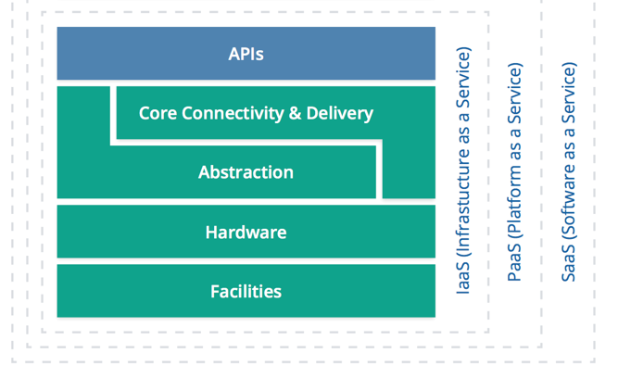
Infrastructure as a Service(IaaS)
The customer then can install its own software or interact with the computing infrastructure via a set of abstractions and/or APIs.
The consumer does not manage or control the underlying cloud infrastructure but has control over operating systems, storage, deployed applications, and possibly limited control of select networking components (e.g., host firewalls).
Notes:
IaaS is likened to running your own data center, but without having to worry about the details. The provider offers:
Facilities
Hardware
The customer then can install its own software or interact with the computing infrastructure via a set of abstractions and/or APIs. So for example, the provider will access to the virtual “server” that happens to reside within the providers infrastructure.
The consumer does not manage or control the underlying cloud infrastructure but has control over operating systems, storage, deployed applications, and possibly limited control of select networking components (e.g., host firewalls).

Slide 131
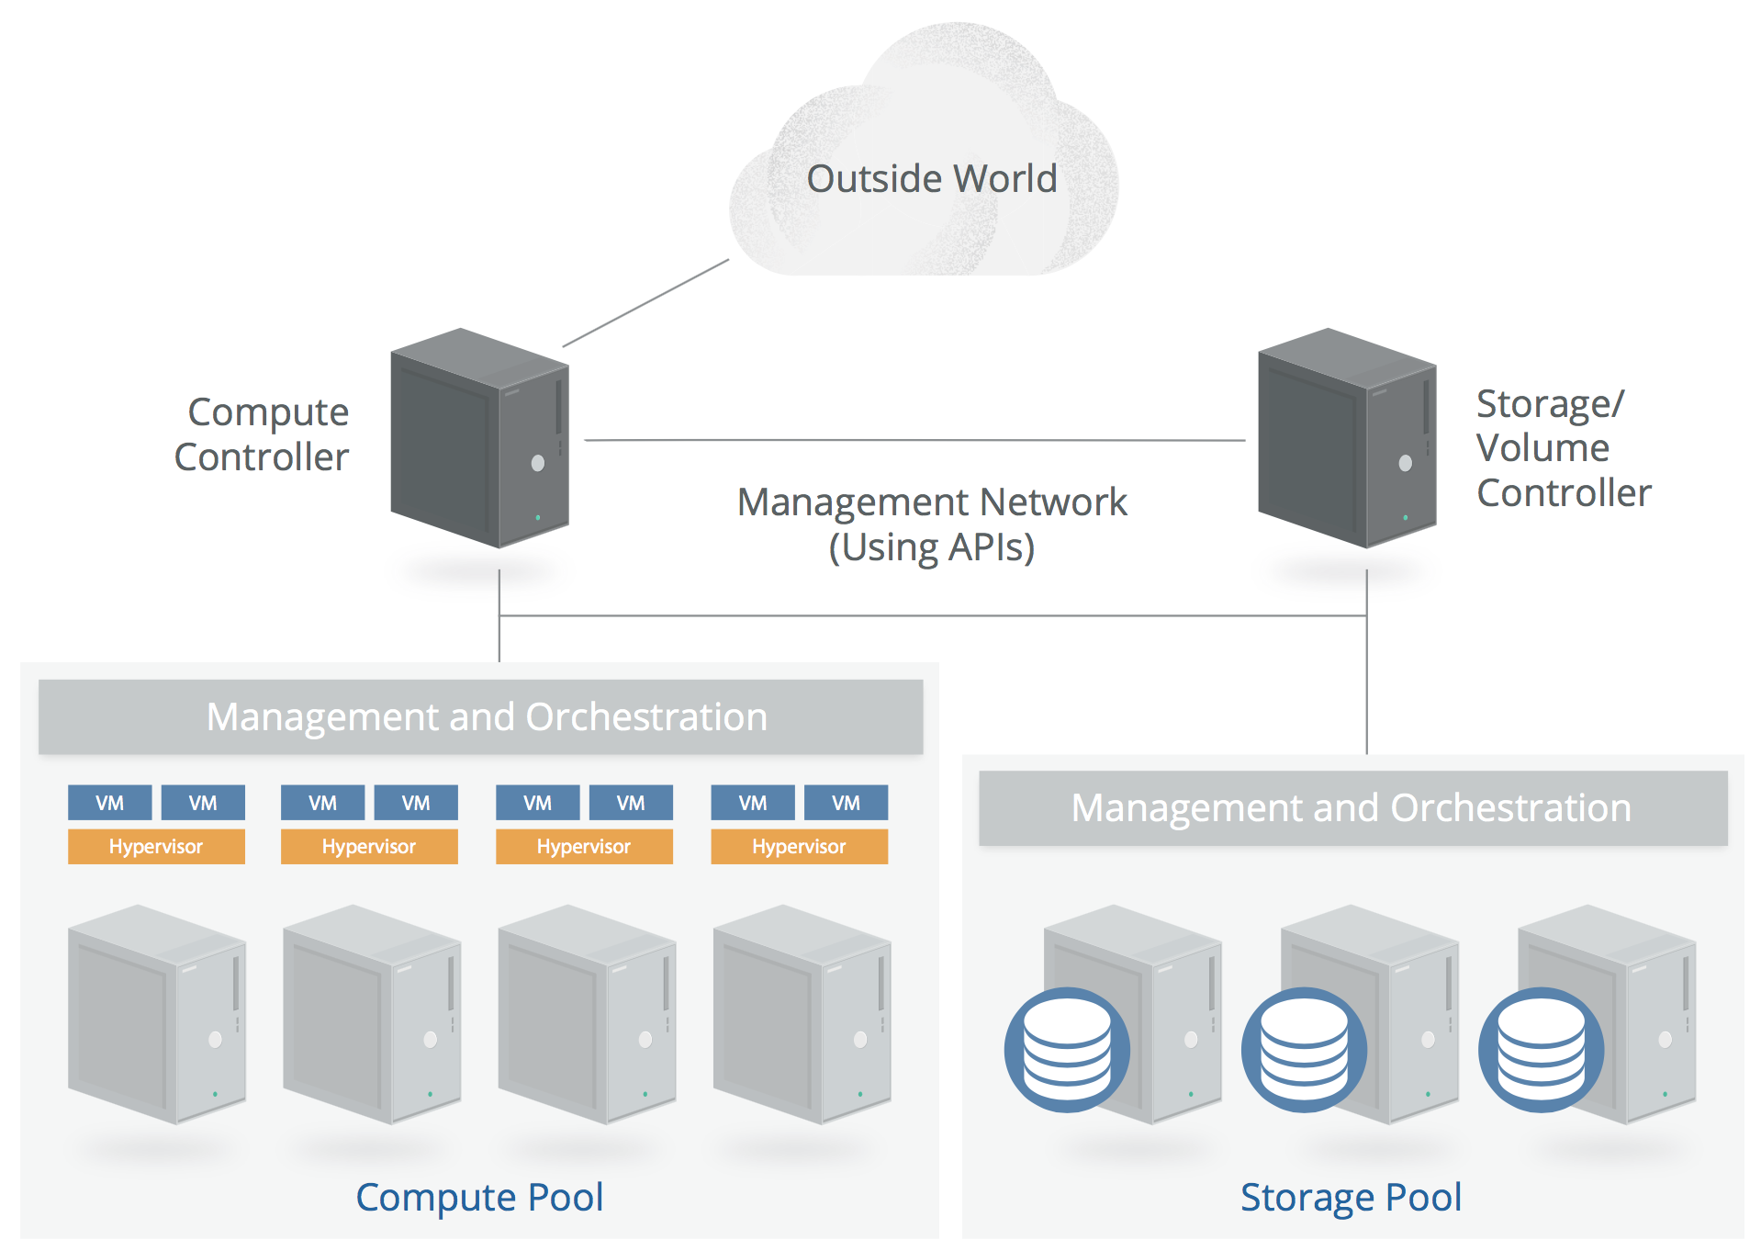
Simplified IaaS Architecture

Slide 132
Platform as a Service(PaaS)
Application development frameworks, middleware capabilities, as well as functionalities like databases, messaging, queues, etc.
Deploying services created or acquired by users to cloud infrastructure
Creating applications using programming languages and tools supported by cloud providers
Notes:
PaaS is the next level up, further abstracting the hardware by providing access via middleware or other integrations offered by the provider.
To be clear:
The consumer does not manage or control the underlying cloud infrastructure including network, servers, operating systems, or storage.
The consumer has control over the deployed applications and possibly application hosting environment configurations, but none of the configurations of the underlying infrastructure.

Slide 133
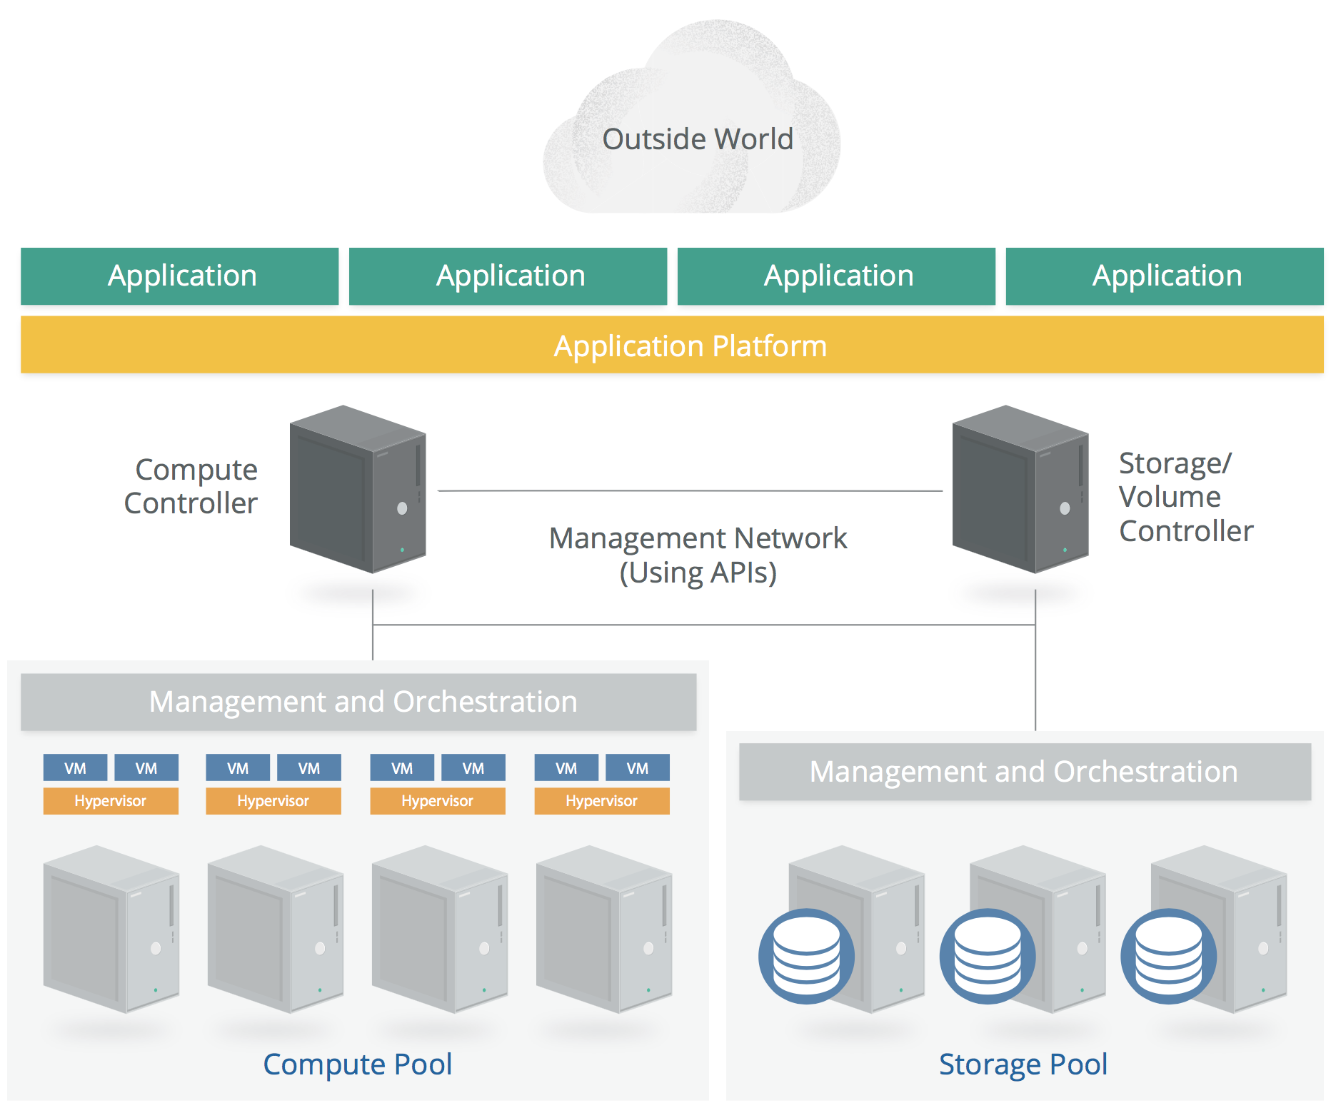
Simplified PaaS Architecture

Slide 134

Software as a Service(SaaS)
Users utilize applications provided by service providers.
SaaS doesn't necessarily have to run on IaaS or PaaS, but still needs to have basic cloud characteristics.
Users cannot manage or control the underlying infrastructure including networks, servers, operating systems, storage, or even individual application capabilities.
Notes:
The applications are accessible from various client devices through a thin client interface such as a web browser (e.g., web-based email).
Consumers may have limited user-specific application configuration settings, as well as limited ability to customize the application.
Examples of prominent SaaS applications include:
Salesforce.com
Gmail
Quickbooks Online
MailChimp (email list management)
Marketo (marketing automation)
Workday (HR and accounting)

Slide 135
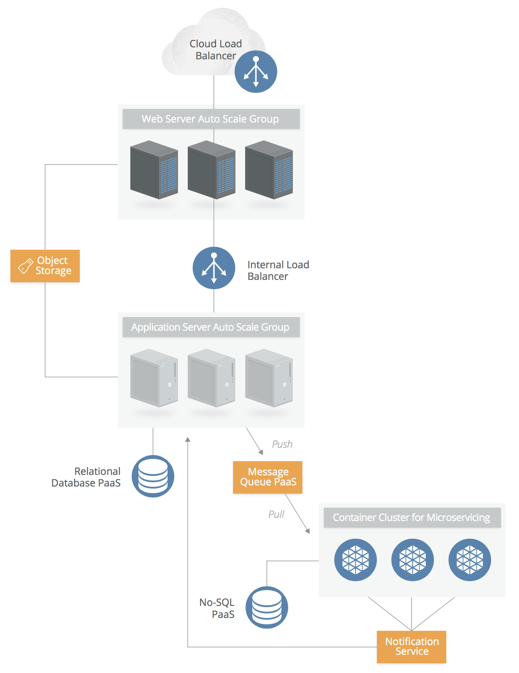
Simplified SaaS Architecture
Notes:
This architecture will be discussed in detail in the next module.

Slide 136
Introduction to Cloud Computing
Security on Cloud Services
Cloud Storage Security
Cloud Application Security and Access Control
Introduction to Internet of Things
IoT Security and Cloud
Module 5 – Cloud and IoT Security

Slide 137
macro layers
Management plane
Virtual infrastructure
Fundamental resources
Notes:
In cloud computing, there are two macro layers to infrastructure, plus the management plane that ties them together:
• The fundamental resources pooled together to create a cloud. This is the raw, physical and logical compute (processors, memory, etc.), networks, and storage used to build the cloud’s resource pools. For example, this includes the security of the networking hardware and software used to create the network resource pool.
• The virtual/abstracted infrastructure managed by a cloud consumer. That’s the compute, network, and storage assets that they use from the resource pools. For example, the security of the virtual network, as de ned and managed by the cloud consumer.
The information and advice in this domain primarily focuses on the second macro layer, infrastructure security for the cloud consumer. Infrastructure security that’s more fundamental for cloud providers, including those who manage private clouds, is well aligned with existing security standards for data centers.

Slide 138
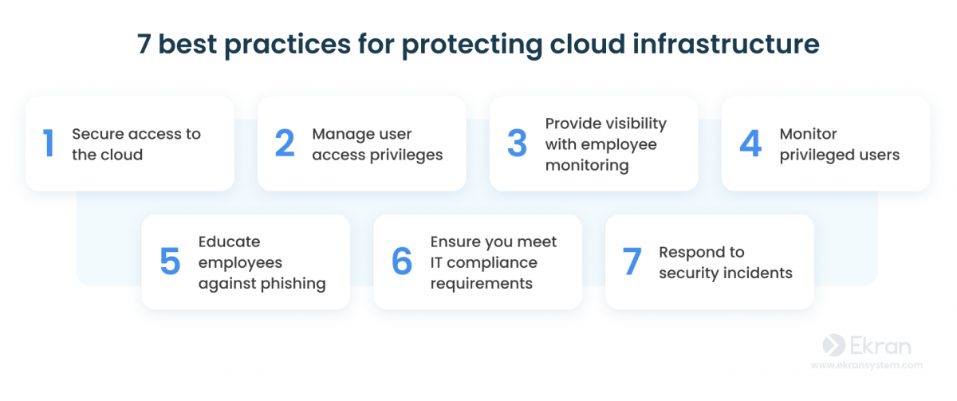

Slide 139
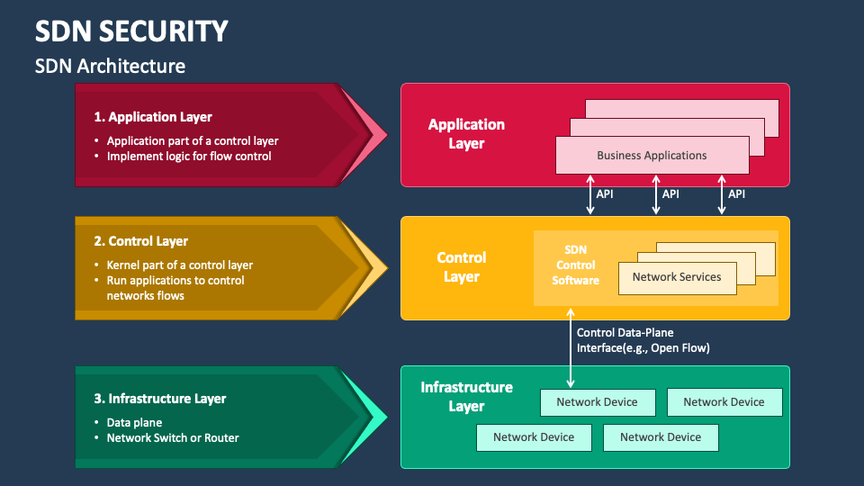

Slide 140
macro layers
Security Suggestions
Management plane
Virtual infrastructure
Fundamental resources
Notes:
In cloud computing, there are two macro layers to infrastructure, plus the management plane that ties them together:
• The fundamental resources pooled together to create a cloud. This is the raw, physical and logical compute (processors, memory, etc.), networks, and storage used to build the cloud’s resource pools. For example, this includes the security of the networking hardware and software used to create the network resource pool.
• The virtual/abstracted infrastructure managed by a cloud consumer. That’s the compute, network, and storage assets that they use from the resource pools. For example, the security of the virtual network, as de ned and managed by the cloud consumer.
The information and advice in this domain primarily focuses on the second macro layer, infrastructure security for the cloud consumer. Infrastructure security that’s more fundamental for cloud providers, including those who manage private clouds, is well aligned with existing security standards for data centers.

Slide 141
Suggestions on Virtual Infrastructure
It's preferable to use SDN if available.
Utilize SDN functionality for multiple virtual networks and multiple cloud accounts/segments to enhance network isolation.
Independent accounts and virtual networks greatly limit the scope of harm compared to traditional data centers.
Implement default deny on cloud firewalls.
Base cloud firewall policies on each workload rather than per network application.
Use cloud firewall policies to restrict communication between workloads within the same virtual subnet as much as possible, such as using security groups.
Notes:
This is a summary of what we’ve talked about. It comes down to understanding how you can monitor and filter traffic on your cloud platform, and picking the right layers to focus your efforts. This varies quite a bit based on the cloud platform- with some offering robust connections for different network security tools, and others offering absolutely nothing.
Watch out for virtual appliances as a complete replacement for physical appliances. While they work, they will likely run into performance issues with any significant volume of traffic on the virtual network. On the other hand, injecting a physical appliance may create its own performance issues. This is a rapidly evolving area and one that’s beyond the scope of this class to fully delve into.

Slide 142

Suggestions on Fundamental Resources
Maintain security controls for long-running workloads using tools that can identify the cloud environment.
Disable remote access.
Integrate security testing into the image creation process.
Set up alerts and file integrity monitoring.
Patch by updating images rather than directly patching running instances.
Select security agents that are cloud-aware and minimize performance impact.
Store logs externally from the workload.
Understand and comply with the cloud provider's limitations on vulnerability assessments and penetration testing.

Slide 143

Suggestions on Management Plane
Ensure that API gateways and web consoles have sufficient perimeter security.
Utilize strong authentication and multi-factor authentication.
Strictly control the credentials of the main account holder/root account and consider dual authorization access to them.
Establishing multiple accounts with your provider will help with account granularity and limit the scope of harm (using IaaS and PaaS).

Slide 144
Introduction to Cloud Computing
Security on Cloud Services
Cloud Storage Security
Cloud Application Security and Access Control
Introduction to Internet of Things
IoT Security and Cloud
Module 5 – Cloud and IoT Security

Slide 145
Cloud Storage Security - Suggestions
Understand the unique capabilities of the cloud platform you are using.
Don't overlook data security from the cloud provider. In many cases, it's more secure and cost-effective than self-building.
Create an authorization matrix for access control decisions. There are significant differences in execution capabilities based on the cloud provider's abilities.
Select appropriate encryption options based on threat models tailored to data, business, and technical requirements.

Slide 146
Cloud Storage Security – Suggestions – Cont.
Consider using provider-managed encryption and storage options. Use user-managed keys where possible.
Leverage architecture to enhance data security. Don't rely solely on access control and encryption.
Ensure that API and data-level monitoring are properly implemented, and logs meet compliance and lifecycle policy requirements.

Slide 147
Introduction to Cloud Computing
Security on Cloud Services
Cloud Storage Security
Cloud Application Security and Access Control
Introduction to Internet of Things
IoT Security and Cloud
Module 5 – Cloud and IoT Security

Slide 148


Slide 149


Slide 150


